Slide 1

COMPETITIVENESS IN THE MEAT INDUSTRY
AUTHOR: GEORGIANA-VALENTINA MEHEȘ (ISAC)
COORDONATOR: LECT. UNIV. DR. IZABELA LUIZA POP
AFFILIATION: TECHNICAL UNIVERSITY OF CLUJ-NAPOCA

Slide 2
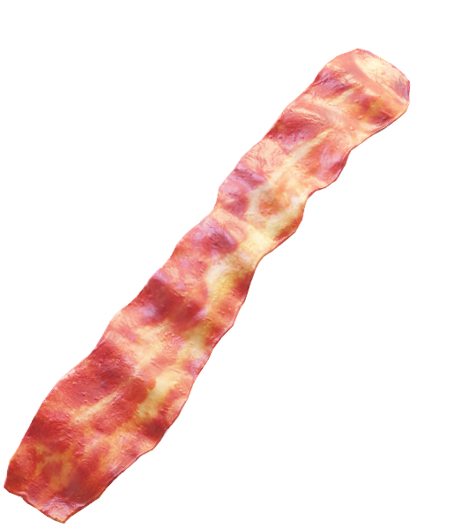
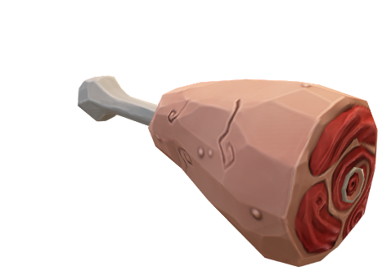

Introduction
Cetina SRL, founded in 1994, is a major player in Romania’s meat processing industry, leveraging competitive strategies and innovation for long-term success.
Cetina SRL exemplifies effective strategic management in the food industry, ensuring growth and adaptability.
Resource control for competitive advantage
Talent retention boosting productivity
Investments in technology and distribution for sustainability
Strategic marketing to strengthen market position
Balanced Scorecard for performance evaluation
Fig. 2. Key strengths
Author: Meheș Georgiana
Fig. 1. Cetina SRL: Company Profile and Strategic Vision

Slide 3
Usefulness, Necessity, and Importance of the Research
📚 Contribution to Literature
Updates perspectives on Romania’s meat industry
Analyzes Cetina SRL as a real-world case
Links theory to market trends
🚀 Strategic Business Impact
Offers successful models for competitors
Improves efficiency, market position, and financial sustainability
🏛 Economic Policies & Regulations
Identifies industry challenges and opportunities
Assesses European funding impact
♻️ Sustainability & Adaptability
Guides resilient business models
Emphasizes diversification and supply chain optimization
This research enhances specialized literature while providing practical insights for competitive strategy in the meat industry.

Slide 4
Research Methods Used in the Study
📖 Secondary Data Analysis
Academic sources (Porter, Kotler & Keller)
Industry reports (Romanian Chamber of Commerce, EU Commission)
Corporate financial records
📊 Financial Performance Assessment
Revenue Growth (+36.21% in 2023)
Profit Margin (+71.6% net profit increase)
Efficiency Metrics (ROA 24.42%, stock turnover rate 8)
🧐 Qualitative Case Study
Modern slaughterhouses investment
Retail expansion (23 outlets + supermarket partnerships)
Workforce development
♻️ Sustainability & Crisis Response
Supply chain resilience (Hungarian suppliers)
Operational adaptability (market diversification)
Eco-conscious production
⚔️ Competitive Analysis – Porter’s Five Forces
New entrants → Market barriers
Supplier power → Livestock sourcing strategy
Buyer power → Customer-driven pricing
Industry rivalry → Competition (Carmangeria Dalia SRL)
Substitutes → Plant-based alternatives

Slide 5
Fig. 3. The evolution of Cetina SRL
Author: Meheș Georgiana
Evolution
THE EVOLUTION OF CETINA SRL
Expansion & Market Presence: From a rented 120 m² space with 7 employees, Cetina now operates 23 retail stores, supplies 50+ supermarkets, and employs over 270 people, producing 10 tons of meat products daily.
Resilience & Adaptability: During crises like COVID-19, Cetina adjusted its distribution strategy, targeting smaller retailers and maintaining workforce stability. This flexibility reinforced its position as an industry leader.
Innovation & Sustainability: The company balances traditional values with modern technology, integrating efficient resource management, quality control, and strategic investments to stay competitive.
Study Objectives: This paper analyzes Cetina’s operational strategies, commercial strength, financial stability, and human resources, highlighting key factors behind its sustained market leadership.

Slide 6
Operational Diagnosis – Efficiency & Growth Strategies
Technological Investments and Self-Sufficiency in Raw Materials:
Crisis Adaptability, Sustainability & Scalability and Customer-Centric Approach:
During COVID-19, Cetina redirected its distribution to smaller retailers, ensuring product availability and workforce stability.
Expanded from 200 kg daily production to multiple tons, with a focus on waste reduction and resource optimization.
Efficiency and affordability drive strong brand loyalty and consumer trust.
Modern slaughterhouses meet European food safety standards, processing 400 pigs, 100 cattle, 100 horses, or 400 sheep daily with advanced sterilization and packaging technologies.
Own livestock farms ensure consistent quality and cost control, supplemented by efficient Hungarian supplier partnerships.
Indicator | 2019 | 2020 | 2021 | 2022 | 2023 | 2024
Number of Employees | 190 | 210 | 230 | 239 | 259 | 275
Daily Meat Production (kg) | 3,200 | 3,800 | 4,200 | 4,500 | 5,200 | 5,500
Retail Locations | 15 | 17 | 19 | 20 | 23 | 25
Infrastructure Investments (RON) | 8M | 10M | 12.5M | 15M | 19.5M | 22M
Production Efficiency (RON/Employee) | 420,000 | 460,000 | 480,000 | 501,826 | 630,302 | 650,000
Fig. 4. Operational Performance of Cetina SRL(2019-2024)
Author: Meheș Georgiana

Slide 7
Commercial Strategy – Market Presence & Competitive Positioning
Extensive Distribution: Cetina operates 23 retail stores and supplies 50+ supermarkets, ensuring strong market coverage, especially in North-West Romania.
Diverse Product Portfolio: Offers 100+ meat products, balancing traditional recipes with evolving consumer trends.
Pricing & Market Positioning: Affordable yet high-quality products drive strong customer loyalty and steady demand.
Competitive Landscape: Competes with industry leaders, using Porter’s Five Forces to analyze market trends and risks.
Adapting to Consumer Preferences: Potential for product diversification, including alternative proteins to expand market reach.
Challenges & Opportunities: E-commerce expansion and R&D investments can strengthen long-term growth.
Customer-Centric Approach: Focuses on consumer satisfaction and retailer partnerships to maintain a loyal customer base.
Indicator | 2019 | 2020 | 2021 | 2022 | 2023 | 2024
Number of Retail Locations | 15 | 17 | 19 | 20 | 23 | 25
Supermarket Partnerships | 35 | 40 | 42 | 45 | 50 | 55
Daily Meat Product Deliveries (tons) | 6.5 | 7.2 | 7.8 | 8.5 | 10 | 11
Product Portfolio (unique meat products) | 75 | 80 | 85 | 90 | 100 | 110
Market Regions Covered | 2 | 2 | 3 | 3 | 4 | 5
Competitive Positioning Score (out of 100) | 78 | 81 | 82 | 84 | 89 | 90
Fig. 5. Commercial Performance of Cetina SRL(2019-2024)
Author: Meheș Georgiana

Slide 8
Financial Performance – Growth, Efficiency & Investments
Financial Stability & Strategic Investments: Cetina prioritizes profit reinvestment, improving production capacity and adopting modern processing technologies. Key funding sources, including the 2006 Sapard project, boosted scalability and operational capabilities.
Sustainability & Future Growth: The company is positioned for long-term financial stability, focusing on strategic expansion, innovation, and market adaptability to sustain its competitive edge in Romania's meat industry.
Year | Total Revenue (RON) | Net Profit (RON)
2019 | 85,000,000 | 3,800,000
2020 | 98,000,000 | 4,500,000
2021 | 110,000,000 | 5,200,000
2022 | 119,854,300 | 6,123,410
2023 | 163,246,942 | 10,508,535
2024 | 175,000,000 | 12,000,000
Fig. 6. Financial Performance of Cetina SRL (2019-2024)
Author: Meheș Georgiana

Slide 9
Human Resources Strategy – Workforce Growth & Productivity
Productivity & Performance:
Training & Development: Investment in skill enhancement programs strengthens workforce capabilities, improving innovation and operational excellence.
Employee Satisfaction & Retention: Cetina prioritizes workplace stability, fair wages, and career growth, fostering long-term employee loyalty and engagement.
Future HR Strategies: Expansion of training initiatives, digital workforce tools, and leadership development will further boost productivity and competitiveness.
Indicator | 2019 | 2020 | 2021 | 2022 | 2023 | 2024
Number of Employees | 190 | 210 | 230 | 239 | 259 | 275
Employee Retention Rate (%) | 88% | 89% | 90% | 91% | 93% | 94%
Average Earnings per Employee (RON) | 38,000 | 40,500 | 42,800 | 41,841 | 48,263 | 50,000
Productivity per Employee (RON) | 420,000 | 460,000 | 480,000 | 501,826 | 630,302 | 650,000
Training & Development Investment (RON) | 2M | 2.2M | 2.4M | 2.5M | 3.2M | 3.5M
Fig. 7. Human Resources Performance of Cetina SRL (2019-2024)
Author: Meheș Georgiana

Slide 10
Fig. 8. Key Success Factors
Author: Meheș Georgiana
Factors of success
Cetina SRL has established itself as a market leader in Romania’s meat processing industry through strategic investments, operational efficiency, and adaptability. Its focus on technological advancements, self-sufficient sourcing, and resilient distribution has resulted in consistent profitability, including a 71.6% profit increase in 2023.
Operational Excellence:
Investments in modern slaughterhouses and advanced processing technologies have strengthened efficiency. Self-sufficient sourcing ensures quality control and cost stability, reducing dependence on external suppliers.
Commercial Competitiveness:
A robust distribution network of 23 retail stores and 50+ supermarket partnerships enhances market reach. Competitive pricing strategies balance affordability and quality, maintaining strong customer loyalty.
Financial Resilience & Workforce Growth:
Steady financial growth, supported by EU-backed projects, has reinforced long-term stability. An 8.37% workforce expansion and investments in training programs improve employee retention and productivity.
Cetina SRL’s continued focus on innovation, sustainability, and customer-centric strategies ensures lasting market leadership in an evolving industry.

Slide 11
1. Product Diversification: Expand offerings to include health-conscious options such as organic, lean meats, and plant-based alternatives to attract new consumer segments. Develop premium and specialty products to differentiate from competitors and enhance brand positioning.
2. Market Expansion: Strengthen international presence through exports and strategic partnerships, targeting European markets with high demand for quality meat products. Invest in e-commerce platforms to improve accessibility and tap into digital consumer trends.
3. Sustainability Initiatives: Implement eco-friendly packaging and energy-efficient production methods to align with global sustainability standards. Optimize waste management and resource utilization to reduce environmental impact and improve operational efficiency.
4. Digital Transformation & Innovation: Leverage AI-driven analytics for market trends, consumer behavior insights, and demand forecasting. Enhance automation in production and logistics to improve efficiency and reduce costs.
5. Workforce Development & Retention: Expand training programs to foster innovation and improve employee skill sets. Strengthen employee engagement strategies to boost retention and maintain a motivated workforce. By focusing on innovation, sustainability, and market adaptability, Cetina SRL can reinforce its industry leadership and ensure long-term profitability.
Recommendations
Fig. 9. Recommendations for a strategic growth and sustainability
Author: Meheș Georgiana

Slide 12
Bibliography
[1] Porter, Michael E. Competitive Strategy: Techniques for Analyzing Industries and Competitors. Free Press, 1980.
[2] Kotler, Philip, and Kevin Lane Keller. Marketing Management. Pearson Education, 15th Edition, 2015.
[3] Kaplan, Robert S., and David P. Norton. The Balanced Scorecard: Translating Strategy into Action. Harvard Business Review Press, 1996.
[4] Armstrong, Michael. A Handbook of Human Resource Management Practice. Kogan Page, 14th Edition, 2017.
[5] Barney, Jay B., and William S. Hesterly. Strategic Management and Competitive Advantage: Concepts and Cases. Pearson, 5th Edition, 2014.
[6] Porter, Michael E. "The Five Competitive Forces That Shape Strategy." Harvard Business Review, January 2008.
[7] Kaplan, Robert S., and David P. Norton. "Using the Balanced Scorecard as a Strategic Management System." Harvard Business Review, July-August 2007.
[8] Barney, Jay B. "Firm Resources and Sustained Competitive Advantage." Journal of Management, Vol. 17, No. 1, 1991.
[9] Cetina SRL Official Website. [Cetina.ro](https://cetina.ro/)
[10] Romanian Business Registry. [Top Firme](https://www.topfirme.com/afacere/cetina-s-r-l-/kyg8148ok/)
[11] European Commission. "Food Safety and Hygiene Standards." [ec.europa.eu](https://ec.europa.eu)
[12] Sapard Program Report. "Impact of EU Funding on Romanian Agricultural Enterprises." European Commission, 2006.
[13] Romanian Meat Industry Analysis. "Market Trends and Competitive Landscape." Romanian Chamber of Commerce, 2023.
[14] Armstrong, Michael. Performance Management: Key Strategies and Practical Guidelines. Kogan Page, 5th Edition, 2020.
[15] Hill, Charles W. L., and Gareth R. Jones. Strategic Management: An Integrated Approach. Cengage Learning, 12th Edition, 2019.

Slide 13


