Slide 1
Making Stepping Stones from Stumbling Blocks in Automatic Adaptive Quadrature
Authors: Gh. Adam and S. Adam
Affiliation: IFIN-HH, Măgurele & LIT-JINR, Dubna
(adamg@nipne.ro adams@nipne.ro
adamgheorghe13@gmail.com adam.sanda7@gmail.com)
XGEN International Conference on Science Communications, Baia Mare, Technical University of Cluj-Napoca, May 20–24, 2024

Slide 2
Four Steps of a Numerical Solution
● The sound numerical solution of a research, high tech engineering, or economics problem involves a four step process:
(i) formulation of the underlying mathematical model;
(ii) design of an algorithm for solving the mathematical model in a finite number of steps;
(iii) a computer code algorithm implementation, enabling floating point computations;
(iv) (for expert implementation) optimization of the information flow on different available hardware architectures (cache-based memory hierarchy, distributed memory access, GPU accelerators).
● The present lecture illustrates this four step process for the numerical solution of the Riemann integrals by automatic adaptive quadrature (AAQ), which was promoted by the rich, half century, accumulated empirical evidence as the most performant numerical method devoted to this aim.

Slide 3
Why Addressing the Riemann Integrals?
● As a fundamental part of the calculus, the Riemann integral (RI) was studied and refined over the field ℝ of the real numbers during more than two and half centuries. A cornucopia of specific RI classes was unveiled, the solutions of which exist and are finite for a huge variety of properties of the integrand functions f(x) and extensions of the integration domain [a, b] over the real axis ℝ.
● The Riemann integrals provide convenient representations of the special functions of the mathematical physics. They are universally present in the scientific research, the high tech engineering, the economics, etc.
● The computing is a sine qua non for the successful derivation of solutions of the RIs of interest.
● New algorithmic developments are needed to get code robustness and reliability enhancement, hence reduction of the code fragility, as compared to the existing software for solving RIs.

Slide 4
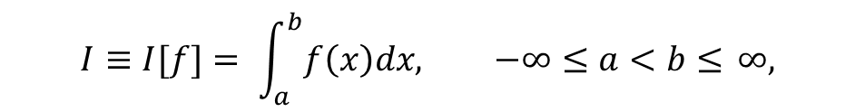
The Mathematical and Numerical Problems
● The theory of the Riemann integral (RI) of interest below,
establishes the conditions to be fulfilled by the real valued integrand function f(x) such that I exists and is finite over the finite or infinite integration domain [a, b] ⊆ ℝ.
● The derivation of a numerical solution of the RI asks for preliminary clarification of two, computer hardware dependent, problems:
●● Mapping the infinite continuous input sets {x, f(x) | x ∈ [a, b]} onto the discrete set of the available machine numbers (the floating point numbers).
This feature of the numerical solution works against the output reliability.
●● The inner organization of the information flow from the processor(s) to the intermediary storage buffers may be done efficiently by correctly pinpointing the kind of the hardware structure at hand: cache-based memory hierarchy, distributed memory access, GPU accelerators.
$$I≡I[f]= \int_{a}^{b}{f\left(x\right)dx, −∞≤a<b≤ }∞,$$

Slide 5
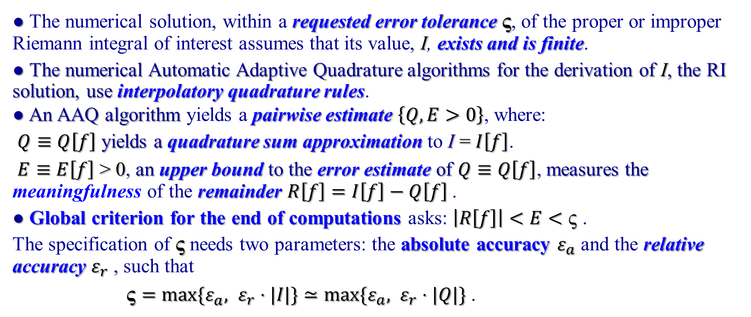
Standard Approach to the Derivation of Numerical Solution
● The numerical solution, within a requested error tolerance ς, of the proper or improper Riemann integral of interest assumes that its value, I, exists and is finite.
● The numerical Automatic Adaptive Quadrature algorithms for the derivation of I, the RI solution, use interpolatory quadrature rules.
● An AAQ algorithm yields a pairwise estimate $\left\{Q, E>0\right\}$, where:
$Q≡Q\left[f\right]$ yields a quadrature sum approximation to I = $I\left[f\right]$.
$E≡E\left[f\right]$ > 0, an upper bound to the error estimate of $Q≡Q\left[f\right]$, measures the meaningfulness of the remainder $R\left[f\right]=I\left[f\right]−Q\left[f\right]$.
● Global criterion for the end of computations asks: $\left|R\left[f\right]\right|<E<\text{ς}$.
The specification of ς needs two parameters: the absolute accuracy $ε_{a}$ and the relative accuracy $ε_{r}$ , such that
$\text{ς}=\max{{\{ε}_{a}, }$ $ε_{r}⋅|I|\}≃\max{{\{ε}_{a}, }$ $ε_{r}⋅|Q|\}$ .

Slide 6
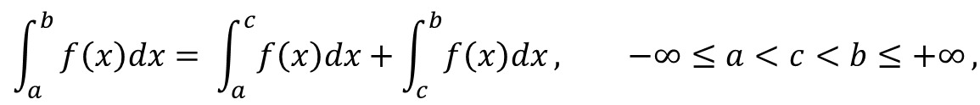
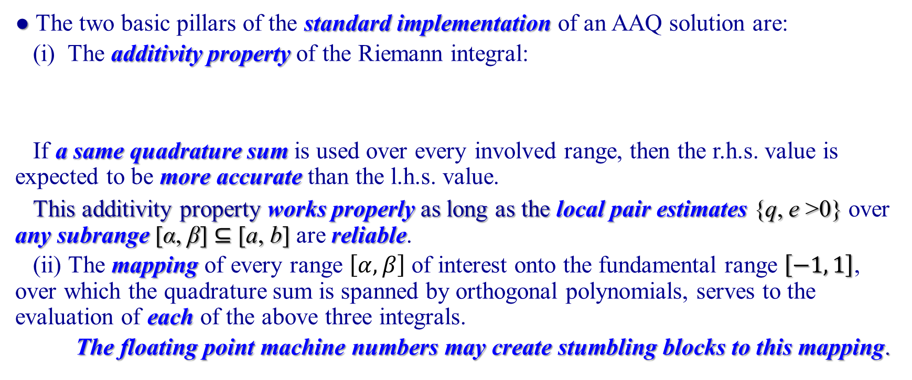
Two Pillars of the Automatic Adaptive Quadrature (AAQ)
● The two basic pillars of the standard implementation of an AAQ solution are:
(i) The additivity property of the Riemann integral:
If a same quadrature sum is used over every involved range, then the r.h.s. value is expected to be more accurate than the l.h.s. value.
This additivity property works properly as long as the local pair estimates {q, e >0} over any subrange [α, β] ⊆ [a, b] are reliable.
(ii) The mapping of every range $\left[α, β\right]$ of interest onto the fundamental range $\left[−1, 1\right]$, over which the quadrature sum is spanned by orthogonal polynomials, serves to the evaluation of each of the above three integrals.
The floating point machine numbers may create stumbling blocks to this mapping.
$$\int_{a}^{b}{f\left(x\right)dx= \int_{a}^{c}{f\left(x\right)dx}+\int_{c}^{b}{f\left(x\right)dx}, −∞≤a<c<b≤+∞},$$

Slide 7
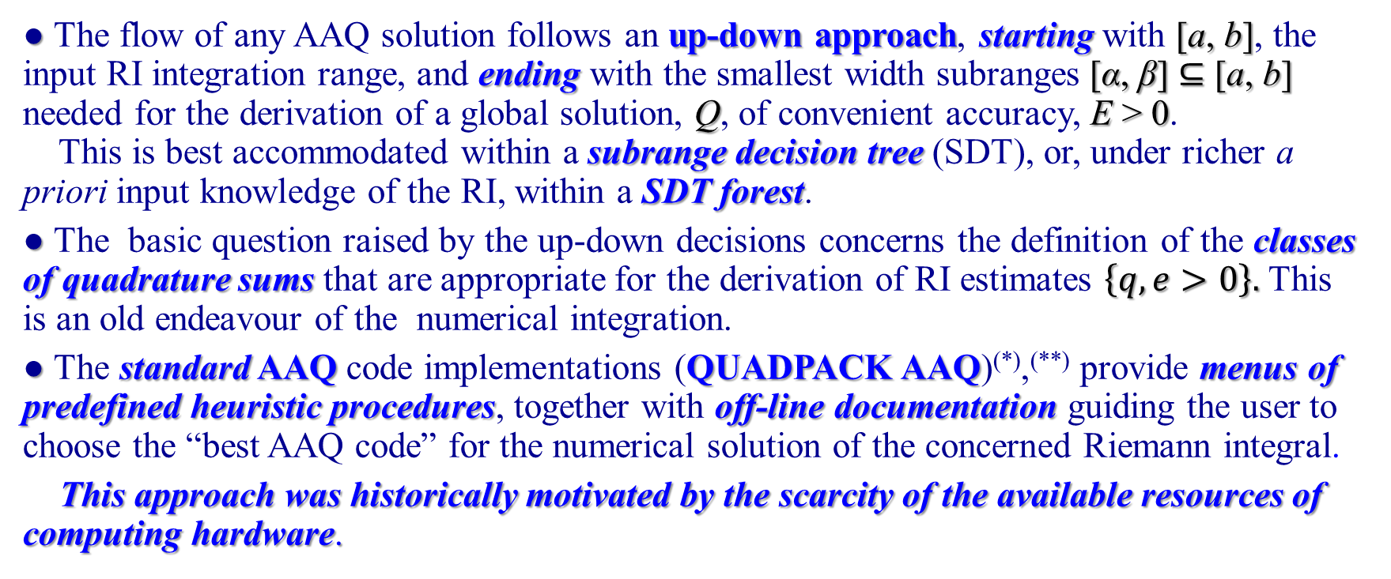
Up-Down AAQ Decisions
● The flow of any AAQ solution follows an up-down approach, starting with [a, b], the input RI integration range, and ending with the smallest width subranges [α, β] ⊆ [a, b] needed for the derivation of a global solution, Q, of convenient accuracy, E > 0.
This is best accommodated within a subrange decision tree (SDT), or, under richer a priori input knowledge of the RI, within a SDT forest.
● The basic question raised by the up-down decisions concerns the definition of the classes of quadrature sums that are appropriate for the derivation of RI estimates $\left\{q, e>0\right\}.$ This is an old endeavour of the numerical integration.
● The standard AAQ code implementations (QUADPACK AAQ)^{(*)},^{(**)} provide menus of predefined heuristic procedures, together with off-line documentation guiding the user to choose the “best AAQ code” for the numerical solution of the concerned Riemann integral.
This approach was historically motivated by the scarcity of the available resources of computing hardware.
^{(*)}R. Piessens, E. de Doncker-Kapenga, C.W. Ueberhuber, and D.K. Kahaner, QUADPACK: A Subroutine Package for Automatic Integration (Springer Series in Comp. Math., vol. 1, Springer Verlag, Berlin, 1983).
^{(**)} NAG Library Manual, Mark 26, D01 (quad) Chapter Introduction, (The Numerical Algorithms Group Ltd., Oxford, UK, 2017) https://www.nag.com/numeric/nl/nagdoc_26/nagdoc_fl26/html/d01/d01intro.html

Slide 8
Quadrature Sums for Reliable and Efficient AAQ Outputs
● The naïve expectation of the 19-th century was that the smoothness property of the integrand function is necessary and sufficient for the achievement of reliable and efficient quadrature algorithms.
● It was spoiled by the Runge phenomenon, which points to the significant quality worsening of the quadrature sums spanned by equally spaced knot Newton-Cotes rules under increasing polynomial degree.
● Recent theoretical studies^{(*)} have clarified two long time known empirical facts:
●● The popularity of the composite three-point Simpson rule during the second half of the 20-th century was motivated by its exceptional robustness.
●● The Runge phenomenon may be kept down by a symmetric interpolatory quadrature sum (SIQS) of high polynomial degree of precision provided the distribution of its quadrature knots is uneven and follows an arccosine law^{(*)} (or an arcsine law showing mirror reflection^{(**)} under the shift of the origins with respect to which the knot location is defined)
^{(*)} H. Brass, K. Petras, Quadrature Theory, The Theory of Numerical Integration on a Compact Interval, American Mathematical Society, Providence, RI, Math. Surv. & Monogr. Vol. 178, 2011
^{(**)} Gh. Adam, S. Adam, Local versus Global Decisions in Bayesian Automatic Adaptive Quadrature, in MMCP 2019 Mathematical Modeling and Computational Physics, EPJ Web of Conferences, Vol. 226, 01001, Gh. Adam, J. Buša, and M. Hnatič, Eds., France: EDP Sciences, 2020, pp. 1–8, https://doi.org/10.1051/epjconf/202022601001 .

Slide 9
Keeping down Runge and Gibbs Phenomena
There are two distinct quadrature rules with arccosine knot distributions:
● The knot distributions within Gauss (and Gauss-Kronrod) (GK) rules secure a prescribed algebraic degree of precision under the use of a minimum number of quadrature knots, being thus preferred by many authors^{(*)}.
● The Clenshaw-Curtis (CC) (and related) rules are spanned by Chebyshev polynomials. These stay closest to the best approximating polynomials of the continuous functions^{(**)}. They enable fast execution (through fast Chebyshev transform), analytically defined and easily computable knot locations and interknot distances, conveniently computed at the compile time and stored as binary input modules.
Both the GK and CC rules get inefficient under the occurrence of finite jump discontinuities in the integrand functions, which entail the Gibbs phenomenon [discovered by Henry Wilbraham (1848) and rediscovered by James Willard Gibbs (1899)].
Here comes into play the use of local three-point Simpson rules, by means of which such discontinuities are solved to working (machine) accuracy.
^{(*)} H. Brass, K. Petras, Quadrature Theory, The Theory of Numerical Integration on a Compact Interval, American Mathematical Society, Providence, RI, Math. Surv. & Monogr. Vol. 178, 2011
^{(**)} L.N. Trefethen, “Is Gauss Quadrature Better than ClenshawCurtis?”, SIAM REVIEW, Vol. 50(1), pp. 67–87, 2008.

Slide 10
Down-Up AAQ Decisions (1)
● Provide Bayesian inferences aimed at overcoming the fragility of the heuristic standard AAQ codes, by avoidance of the glaring errors that might occur along the path to the derivation of the AAQ solution.
● The implementation of down-up AAQ decisions, as a means to enhance the code reliability, was started only recently^{(*)},^{(**)}.
● A first quest regarded the scrutiny of the conditioning of the integrand sampling at the quadrature knots^{(*)} (possibly enhanced with inherited data from parent (sub)ranges).
● This enabled the probabilistic identification of two kinds of ill-conditioned features of the integrand function:
(a) isolated features (pointing to the occurrence of boundary or inner layers of the integrand function);
(b) extended features (pointing to the occurrence of unpredictable changes of the oscillating pattern followed by the computed discretization of the integrand function).
^{(*)} Gh. Adam, S. Adam, Local versus Global Decisions in Bayesian Automatic Adaptive Quadrature, in MMCP 2019 Mathematical Modeling and Computational Physics, EPJ Web of Conferences, Vol. 226, 01001, Gh. Adam, J. Buša, and M. Hnatič, Eds., France: EDP Sciences, 2020, pp. 1–8, https://doi.org/10.1051/epjconf/202022601001 .
^{(**)} Gh. Adam and S. Adam, “A priori Knowledge Driven Input to Bayesian Two-Rule Automatic Adaptive Quadrature”,
in TIM 22 Physics Conference, AIP Conference Proceedings, M. Lungu, Ed., Melville, NY: AIP Publishing, in press.

Slide 11
Down-Up AAQ Decisions (2)
● The up-down approach to the derivation of the AAQ solution uses the subrange decision tree (SDT) formalism.
● A sine qua non requirement for the appropriate implementation of the SDT recursion based solution is the build up of down-up decisions enabling due SDT root characterization.
● The definition of a single SDT root, or of a forest of SDT roots, is to precede the start of the AAQ solution.
It is to be robust and reliable, irrespective of the availability or not of exhaustive a priori off-line knowledge of the features of the Riemann integral needing solution.
● This aim needs the clarification of the input asked for the SDT root characterization.

Slide 12
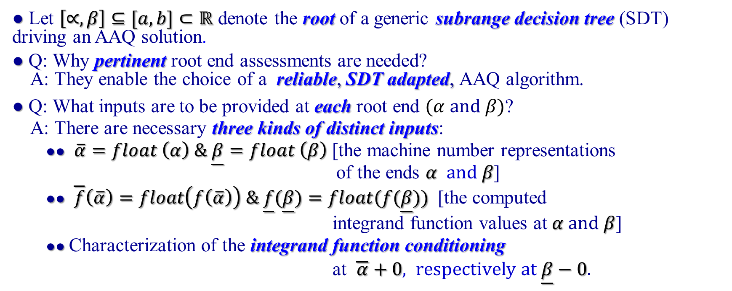
Building up Root Inputs (1)
● Let $\left[∝,β\right]⊆[a,b]⊂ℝ$ denote the root of a generic subrange decision tree (SDT) driving an AAQ solution.
● Q: Why pertinent root end assessments are needed?
A: They enable the choice of a reliable, SDT adapted, AAQ algorithm.
● Q: What inputs are to be provided at each root end $(α and β)$?
A: There are necessary three kinds of distinct inputs:
●● $\overline{α}=float \left(α\right) \& \underline{β}=float \left(β\right)$ [the machine number representations of the ends $α and β$]
●● $\overline{f}\left(\overline{α}\right)=float\left(f\left(\overline{α}\right)\right) \& \underline{f}(\underline{β})=float(f(\underline{β}))$ [the computed
integrand function values at $α and β$]
●● Characterization of the integrand function conditioning
at $\overline{α}+0, respectively at \underline{β}−0.$

Slide 13
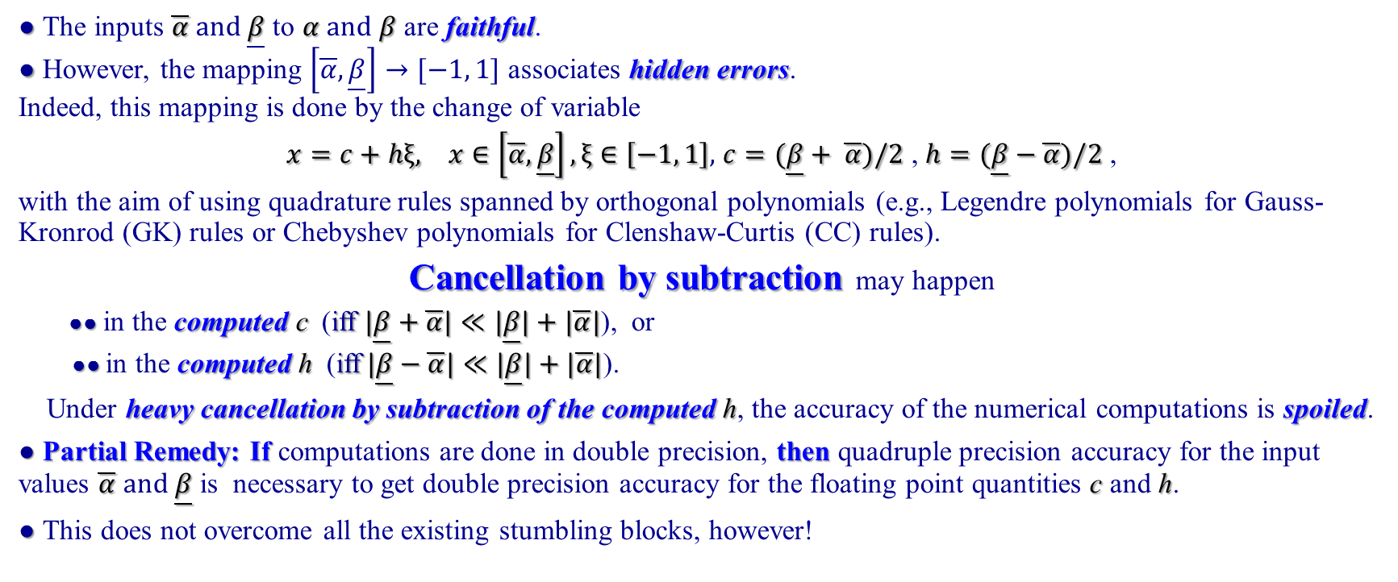
Building up Root Inputs (2)
● The inputs $\overline{α} and \underline{β}$ to $α and β$ are faithful.
● However, the mapping $\left[\overline{α}, \underline{β}\right]→[−1, 1]$ associates hidden errors.
Indeed, this mapping is done by the change of variable
$x=c+hξ, x∈\left[\overline{α}, \underline{β}\right], ξ∈\left[−1, 1\right],$ $c=(\underline{β}+ \overline{α})/2$ , $h=(\underline{β}−\overline{α})/2$ ,
with the aim of using quadrature rules spanned by orthogonal polynomials (e.g., Legendre polynomials for Gauss-Kronrod (GK) rules or Chebyshev polynomials for Clenshaw-Curtis (CC) rules).
Cancellation by subtraction may happen
●● in the computed c (iff $|\underline{β}+\overline{α}|≪|\underline{β}|+|\overline{α}|$), or
●● in the computed h (iff$|\underline{β}−\overline{α}|≪|\underline{β}|+|\overline{α}|$).
Under heavy cancellation by subtraction of the computed h, the accuracy of the numerical computations is spoiled.
● Partial Remedy: If computations are done in double precision, then quadruple precision accuracy for the input values $\overline{α} and \underline{β}$ is necessary to get double precision accuracy for the floating point quantities c and h.
● This does not overcome all the existing stumbling blocks, however!

Slide 14
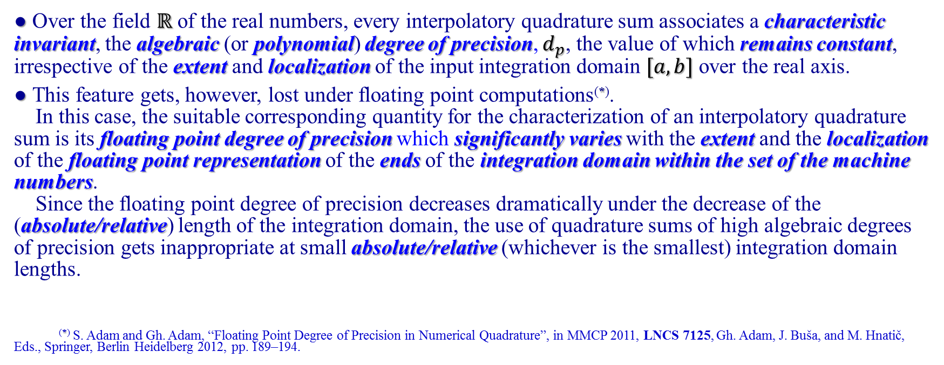
Building up Root Inputs (3)
Fall down of the algebraic degree of precision
● Over the field $ℝ$ of the real numbers, every interpolatory quadrature sum associates a characteristic invariant, the algebraic (or polynomial) degree of precision, $d_{p}$, the value of which remains constant, irrespective of the extent and localization of the input integration domain $[a, b]$ over the real axis.
● This feature gets, however, lost under floating point computations^{(*)}.
In this case, the suitable corresponding quantity for the characterization of an interpolatory quadrature sum is its floating point degree of precision which significantly varies with the extent and the localization of the floating point representation of the ends of the integration domain within the set of the machine numbers.
Since the floating point degree of precision decreases dramatically under the decrease of the (absolute/relative) length of the integration domain, the use of quadrature sums of high algebraic degrees of precision gets inappropriate at small absolute/relative (whichever is the smallest) integration domain lengths.
^{(*)} S. Adam and Gh. Adam, “Floating Point Degree of Precision in Numerical Quadrature”, in MMCP 2011, LNCS 7125, Gh. Adam, J. Buša, and M. Hnatič, Eds., Springer, Berlin Heidelberg 2012, pp. 189–194.

Slide 15
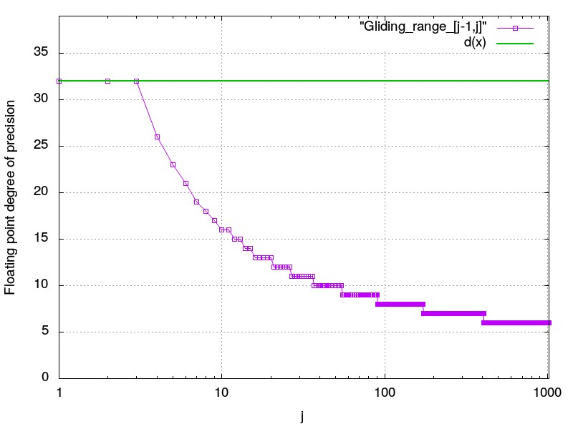
Features of the Floating Point Degree of Precision
Gliding integration range [0,1] on the real axis
The plot gives outputs for the family of 1023 integration ranges
{[j-1, j]; j = 1, 2, ..., 1023}
Legend: Variation of the floating point degree of precision of the CC-32 local quadrature rule over the gliding range [0, 1] versus its distance j from the origin.
It is shown that d_{fp} = d = 32 at low j values (j = 1, 2, 3), then d_{fp} abruptly decreases at larger but small enough j, to show slower decreasing rates under the displacement of [0,1] far away from the origin, reaching a bottom value d_{fp} = 6 at 407 ≤ j ≤ 1023
Clenshaw-Curtis 32
local quadrature rule

Slide 16
Integrand Conditioning at the Root Ends (1)
● Three classes of root ends do exist both for a single subrange decision tree (SDT) and for a forest of SDTs:
●● Outer (left or right) SDT root ends associated to finite integration domain ends;
●● Inner (left and right) SDT root ends inside a forest;
●● Outer (left or right) finite SDT root ends for finite cut-offs of infinite domain ends.
The input pointing to the local lateral integrand function behaviour within the first two classes is fragile, because of either complete lack of such information, or the possibility of a mistaken accidentally provided input.
● The development of a comprehensive predictor–corrector algorithm, providing Bayesian inferences on the integrand function conditioning at each user defined root end, is in progress.
Hereinafter, results reported within a preliminary implementation are discussed for the case study of the outer left SDT root end.^{(*)}
^{(*)} Gh. Adam, S. Adam, ICASC. 2023 International Conference on Advanced Scientific Computing (ICASC) | 979-8-3503-0568-5/23/$31.00 ©2023 IEEE | DOI: 10.1109/ICASC58845.2023.10328030

Slide 17
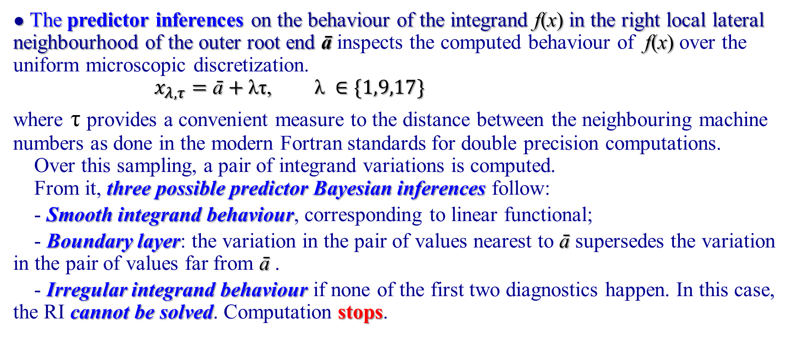
Integrand Conditioning at the Root Ends (2)
● The predictor inferences on the behaviour of the integrand f(x) in the right local lateral neighbourhood of the outer root end $\text{ā}$ inspects the computed behaviour of f(x) over the uniform microscopic discretization.
$x_{λ,τ}=\text{ā}+\text{λτ}\text{, }\text{λ} ∈\{1,9,17\}$
where τ provides a convenient measure to the distance between the neighbouring machine numbers as done in the modern Fortran standards for double precision computations.
Over this sampling, a pair of integrand variations is computed.
From it, three possible predictor Bayesian inferences follow:
- Smooth integrand behaviour, corresponding to linear functional;
- Boundary layer: the variation in the pair of values nearest to $\text{ā}$ supersedes the variation in the pair of values far from $\text{ā}$ .
- Irregular integrand behaviour if none of the first two diagnostics happen. In this case, the RI cannot be solved. Computation stops.

Slide 18
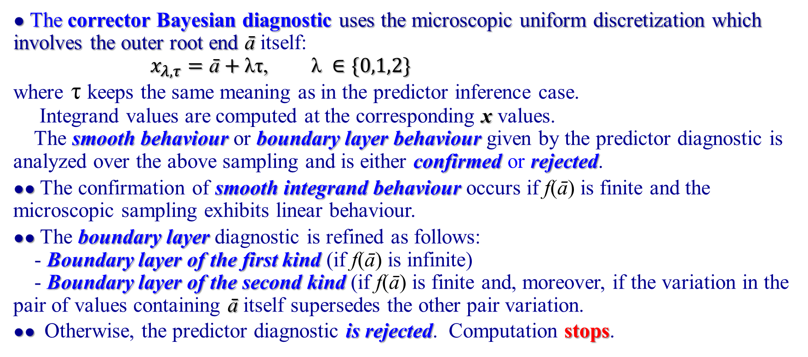
Integrand Conditioning at the Root Ends (3)
● The corrector Bayesian diagnostic uses the microscopic uniform discretization which involves the outer root end $\text{ā}$ itself:
$x_{λ,τ}=\text{ā}+\text{λτ}\text{, }\text{λ} ∈\{0,1,2\}$
where τ keeps the same meaning as in the predictor inference case.
Integrand values are computed at the corresponding x values.
The smooth behaviour or boundary layer behaviour given by the predictor diagnostic is analyzed over the above sampling and is either confirmed or rejected.
●● The confirmation of smooth integrand behaviour occurs if f($\text{ā}$) is finite and the microscopic sampling exhibits linear behaviour.
●● The boundary layer diagnostic is refined as follows:
- Boundary layer of the first kind (if f($\text{ā}$) is infinite)
- Boundary layer of the second kind (if f($\text{ā}$) is finite and, moreover, if the variation in the pair of values containing $\text{ā}$ itself supersedes the other pair variation.
●● Otherwise, the predictor diagnostic is rejected. Computation stops.

Slide 19
Addition Generated Cancellation by Subtraction (1)
● The numerical solution of the Riemann integral involves cancellation by subtraction (CANSUB) over an integration range [a, b] if the computed values of the integrand function f(x) at the quadrature knots over this range results in bounds of variation {f_{u}, f_{b}} of different signs (f_{u} > 0, f_{b} < 0).
● The AAQ procedure usually ends in round off error accumulation.
This is avoided by the definition of three classes of subintervals over [a, b]:
(p) Positive valued discretization subintervals over which all the computed integrand values are nonnegative.
(n) Negative valued discretization intervals over which all the computed integrand values are nonpositive.
(t) Transition elementary intervals, at the ends of which the computed pair of integrand function values involves a strictly positive, respectively a strictly negative value.
Each resolved transition elementary interval is subdivided into a triplet involving specific subintervals of class (p) and class (n) respectively, separated by a tiny central (t) class elementary interval.

Slide 20
Addition Generated Cancellation by Subtraction (2)
● Agglutination of the adjacent class (p) and class (n) subintervals generates subranges which are free of CANSUB effects.
The final result of this procedure yields three kinds of global BAAQ accurate outputs in the presence of the CANSUB effects:
(p): {Q^{(p)} > 0, E^{(p)} > 0} over the union of (p) subintervals;
(n): {Q^{(n)} < 0, E^{(n)} > 0} over the union of (n) subintervals;
(t): {Q^{(t)} = 0, E^{(t)} > 0} over the union of (t) elementary intervals.
Therefrom, the reliable output follows:
Q[f] = Q^{(p)} + Q^{(n)}
Q[|f|] = Q^{(p)} - Q^{(n)}
E[f] = E^{(p)} + E^{(n)} + E^{(t)}
The global termination criterion for the pair {Q[|f|], E[f] > 0} solves the problem of getting the best accuracy solution without attempting the reformulation of the original integral by integration domain folding.

Slide 21
Concluding Remarks (1)
A number of steps of the automatic adaptive quadrature (AAQ) of one-dimensional Riemann integrals (RIs), which are taken for granted in the standard AAQ approach, were found to be fragile. Algorithmic developments have been discussed for the derivation of alternative robust, reliable, and flexible solutions.
The AAQ solutions make use of an up-down recursive two stage subrange decision tree (SDT) strategy. At the initial stage, a solution of the whole RI is attempted within a user provided input either as a single SDT root, or as a forest of SDT roots. If this attempt fails, recursion stages are implemented, which involve definitions of descendent subranges of selected parent ranges.
The QUADPACK implementation assumes that every step of the up-down controlled SDT evolution is possible and necessary.
The BAAQ path involves down-up decisions, which ask for explicit check of the possibility or usefulness to do the implied steps.

Slide 22
Concluding Remarks (2)
The possibility to accept a SDT root at an end where the integrand function conditioning was not defined in advance, is substantiated with the development of a predictor–corrector Bayesian procedure able to provide the missing input for root end characterization, or to correct an accidentally mistaken input concerning this matter.
The derivation of reliable BAAQ solutions under the occurrence of floating point precision loss due to the cancellation by subtraction (CANSUB) was discussed in two distinct cases.
The first case involves the mapping of the input range [a, b] onto the fundamental interval [-1, 1], over which the quadrature sums are spanned by orthogonal polynomial sets. The floating point degree of precision replaces the algebraic degree of precision.
The second case originates in integrand profiles involving computed integrand values of different signs. A robust and reliable decision path is defined, which enables the derivation of the best possible accuracy, which does not ask for the RI reformulation by integration domain folding(s).

Slide 23
Thank you for your attention !

