Slide 1
Development of platform websites for the continuous training of young university studies graduates within industrial companies
Authors: Elena-Andreea ISPAS, Ioana-Mălina CANORIȚĂ, Alexandra-Ioana TATU, Sorin-Cristian PÎRVULESCU, Marian GHEORGHE, Eustațiu DIMA,
Viviana-Maria IACOB, Dan LAZĂR
Affiliation: UNSTPB, FIIR, IEI, …

Slide 2
Content
1. Introduction
2. General elements regarding website platform development
3. Continuous training programs for young specialists
3.1. Opinions of graduates - engineers
3.2. Reference elements
3.3. Case studies
3.4. Content and contact sections of the developed platform website
4. Conclusions
5. Bibliography

Slide 3

1. Introduction
2. General elements regarding developed platform websites
Industry 5.0
Training programes
Human workforce
Methodological framework
Operational systems [1, 2, 3, 4, 5]
Actual platforms are not meant to assist all active categories and fields
Framework structure & integrated support elements: HTML, CSS with TailwindCSS, and JavaScript, React.js, React router [6]
Fig. 1. Platform header

Slide 4
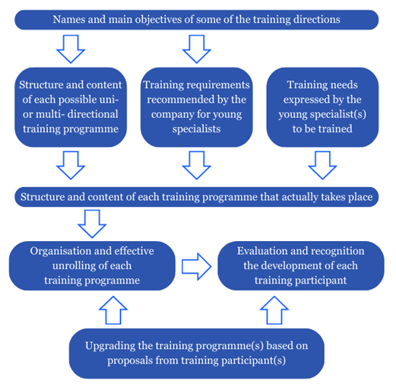
3. Continuous training programs for young specialists
3.1. Opinions of graduates - engineers
3.2. Reference elements
Work environment
“The large volume of new information"
“Solving problems in a very short time"
“Interacting with as many people as possible"
The need to learn a new way of working in a completely unknown area"[7]
Fig. 2. Reference elements for the continuous training of young specialists in industrial companies

Slide 5
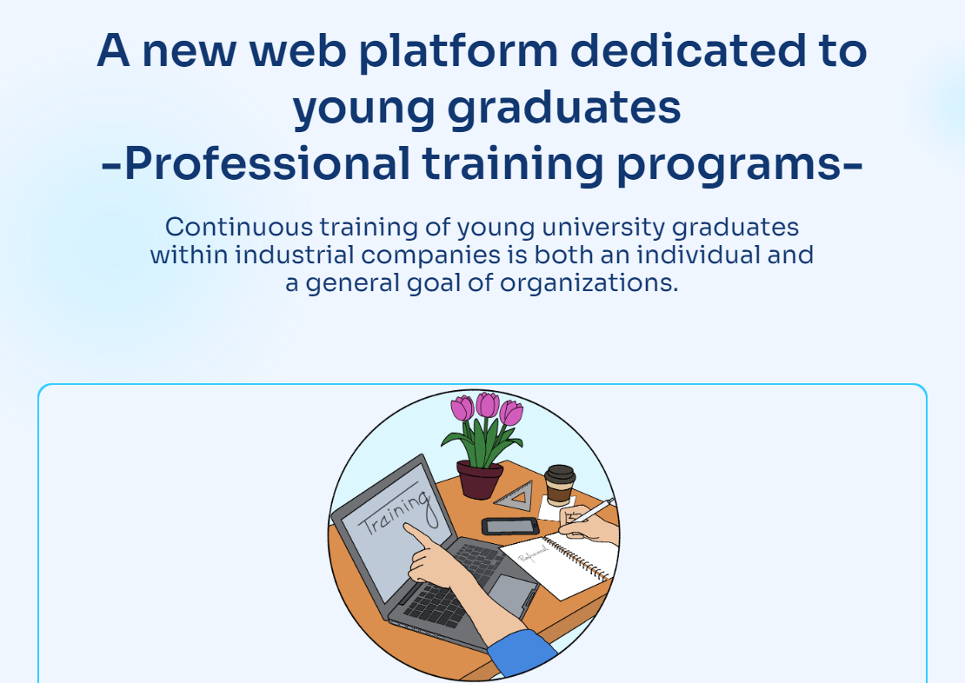
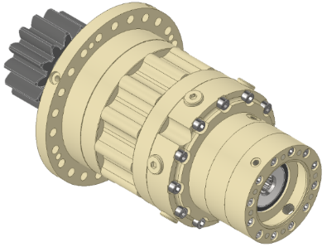
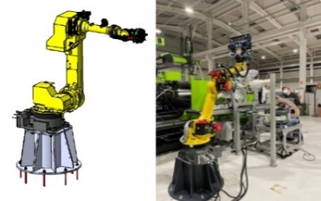
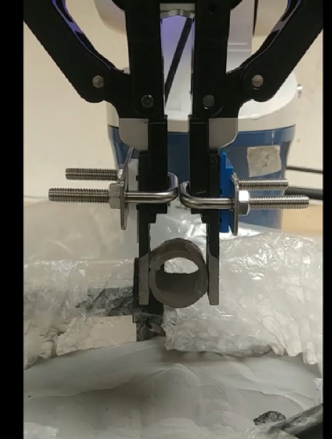
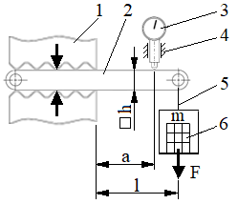
3.3. Case studies
3.4. Content and contact sections of the developed platform structure
Training at SC Automobile Dacia SA
Training at TF Service Impex SRL
Fig. 4, 6, 7, 9 3D Model of the planetary gearbox, industrial robot, diagram of a research,
adapted robot gripper [10, 11, 12, 13]
Fig. 10. Website homepage

Slide 6
4. Conclusions
5. Bibliography
● This paper is presenting models for the development of the continuous training of young university studies graduates, within industrial companies.
● A structure - framework and supporting elements are proposed for the development of platform websites, with open access to young specialists for a variety of professional training programs.
● Useful elements of certain training programmes associated with industrial companies, applied and of perspective, are presented.

