Slide 1
Extraction and characterization of bioactive compounds from Prunus Spinosa L. fruits with potential in the development of edible films
Author/s:
Oana-Raluca NEGREAN
Prof. Dr. Sonia SOCACI
Conf. Dr. Oana POP
Șef Lucr. Dr. Anca FĂRCAŞ
Affiliation:
University of Agricultural Science and Veterinary Medicine Cluj-Napoca

Slide 3
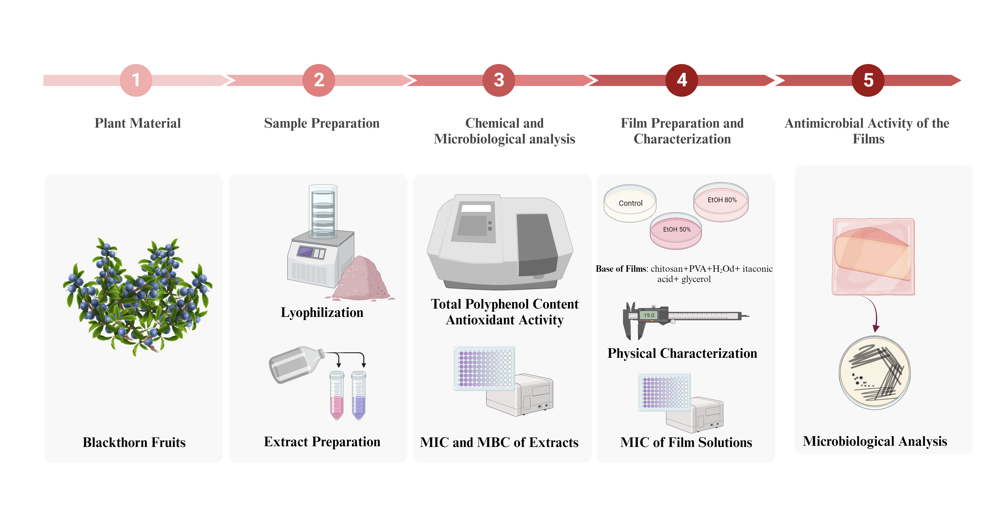

Slide 5
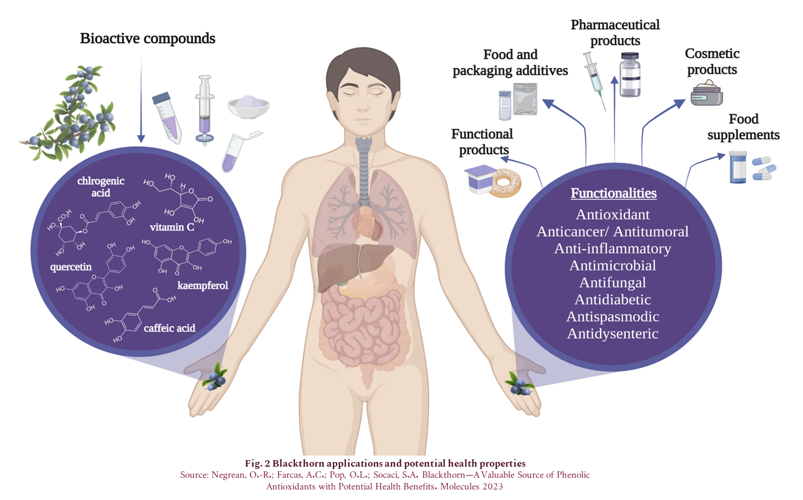

Slide 7
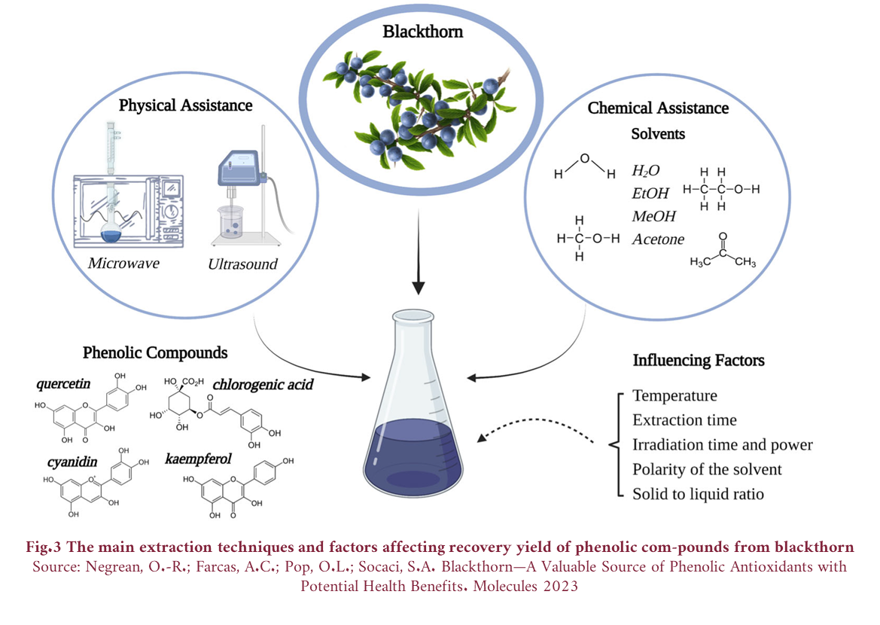

Slide 17
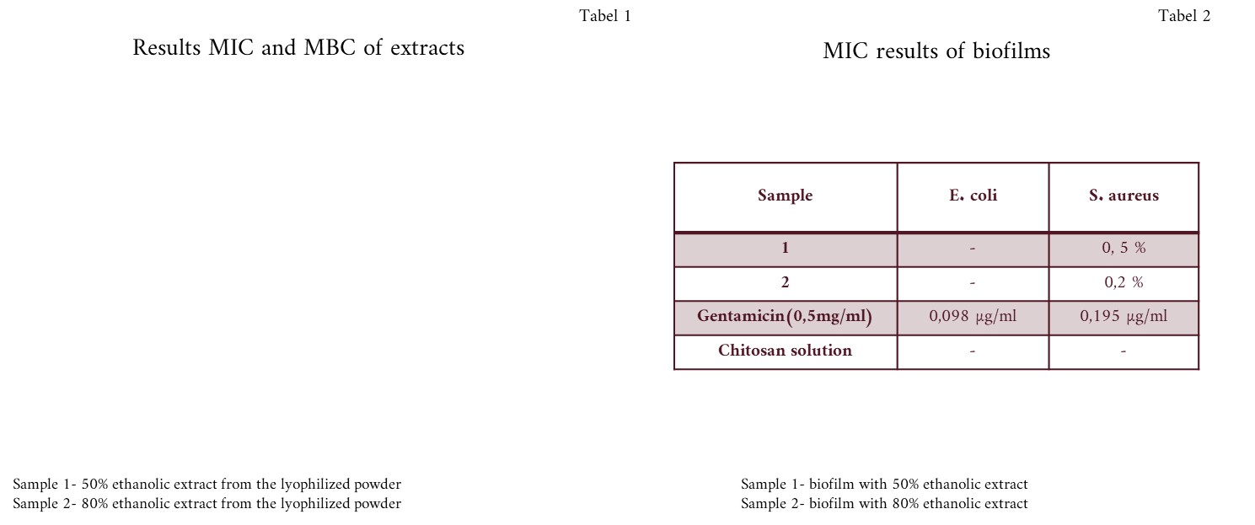
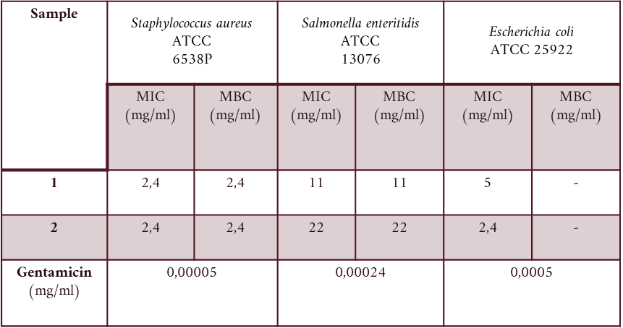

Slide 18
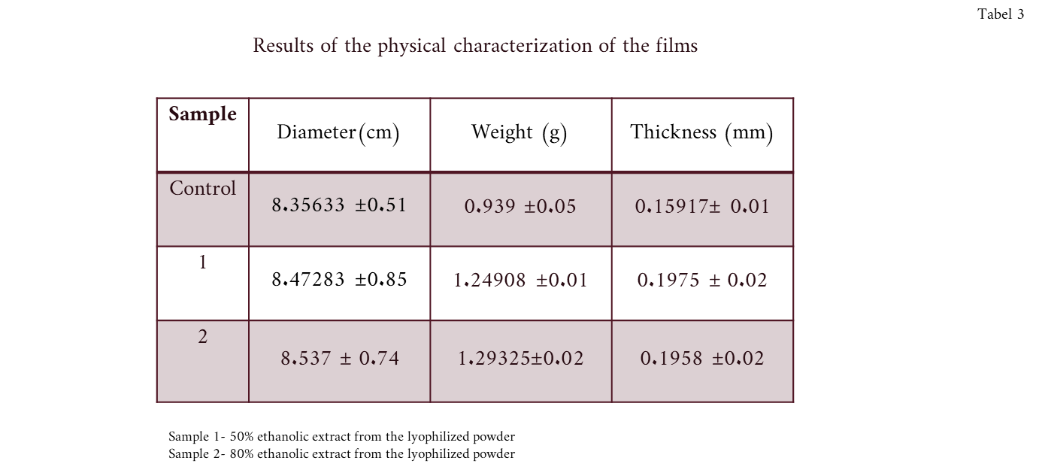

Slide 19
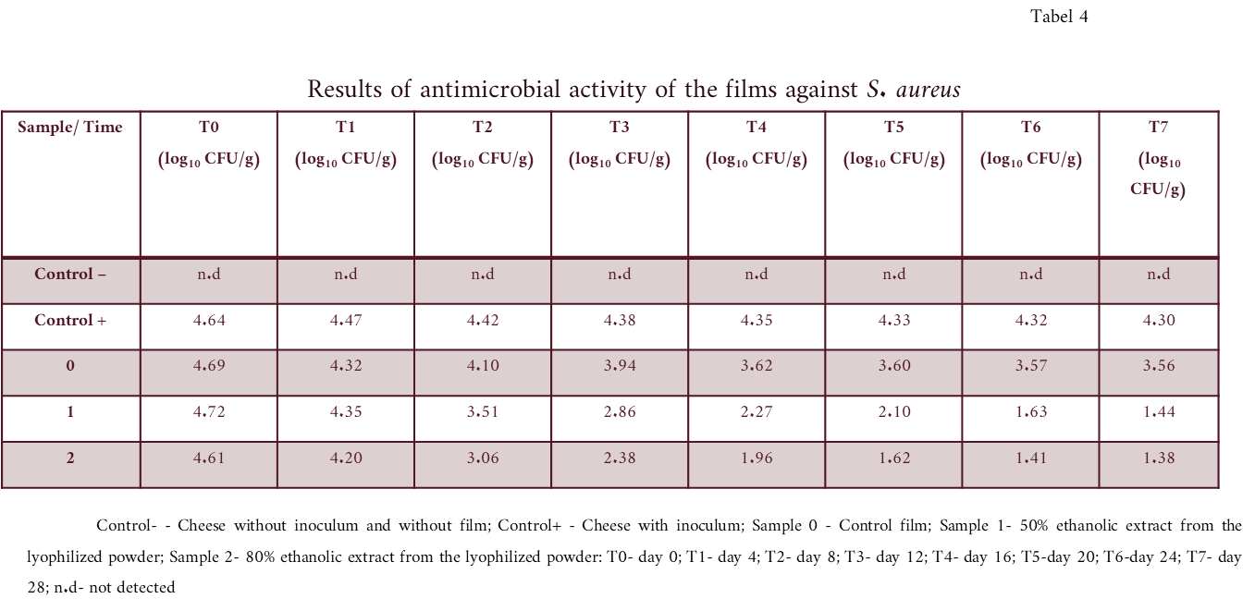

Slide 20
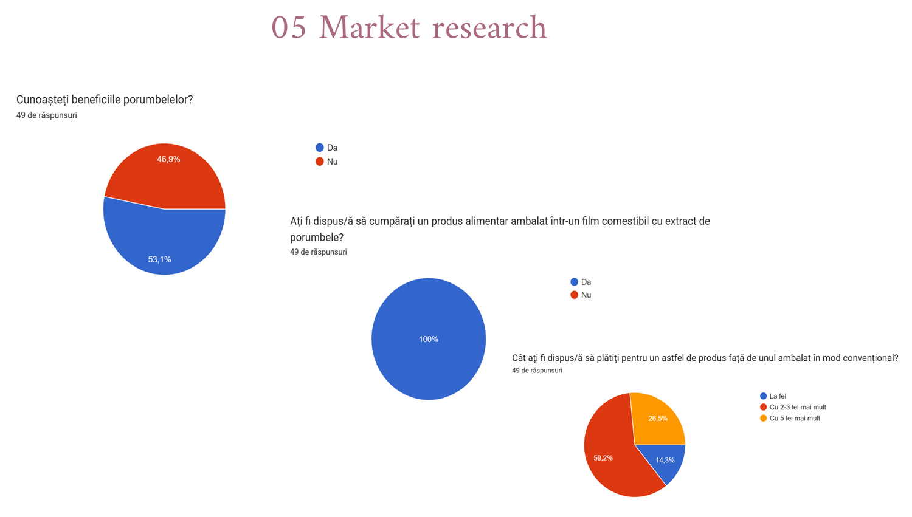

Slide 22
