Slide 1

PARENT
Parental Attitudes Regarding Exercise and Neuromuscular Therapy - The Adapted Version of the MedRisk Instrument for Measuring Parental Satisfaction with Physical
Therapy Services
21 mai 2024
Cherecheș Ștefania, FEFS, KMS, anul II
Coordonator Lect. Dr. Bulduș Codruța Florina
Notes:
PARENT - Parental Attitudes Regarding Exercise and Neuromuscular Therapy

Slide 2
PARENT
Physical therapy
prevention, treatment, rehabilitation
injury, pain, diseases, disorders
Notes:
Physical therapy is services provided by physical therapists to individuals and populations to develop, maintain and restore maximum movement and functional ability throughout the lifespan. The service is provided in circumstances where movement and function are threatened by ageing, injury, pain, diseases, disorders, conditions and/or environmental factors and with the understanding that functional movement is central to what it means to be healthy
Physical therapists are concerned with identifying and maximising quality of life and movement potential within the spheres of promotion, prevention, treatment/intervention and rehabilitation. These spheres encompass physical, psychological, emotional, and social wellbeing.

Slide 3
PARENT
Communication is enough…
or is it?
Notes:
Next year

Slide 4
PARENT
Background
PT, parents, parental satisfaction
Notes:
Ridicati mana kinetoterapie
Ridicati mana parinti cu copii la kinetoterapie ca pacienti (EXPERIENTA FOARTE DIFERITA)
Unele procedure dureroase. Ce simti tu ca parinte? Satisfactie?
Adult- simplu comunicat, parinti si mai greu de comunicat

Slide 5
PARENT
Objective
evaluate parental satisfaction of pediatric PT services
Notes:
Ridicati mana kinetoterapie
Ridicati mana parinti cu copii la kinetoterapie ca pacienti (EXPERIENTA FOARTE DIFERITA)
Unele procedure dureroase. Ce simti tu ca parinte? Satisfactie?
Adult- simplu comunicat, parinti si mai greu de comunicat

Slide 6
PARENT
Methods
Cross-sectional transversal
MedRisk Instrument for Measuring Patient Satisfaction With Physical Therapy Care (MRPS)

Slide 7
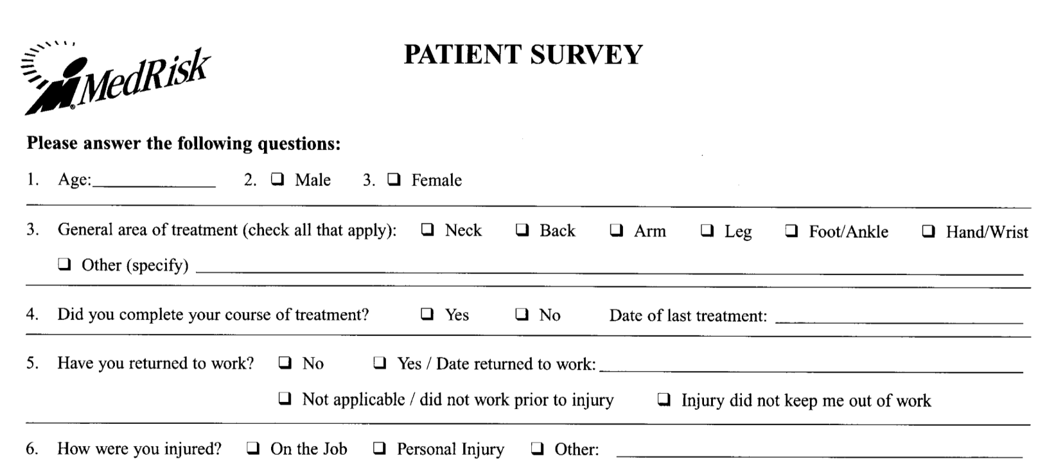
MedRisk instrument
PARENT

Slide 8
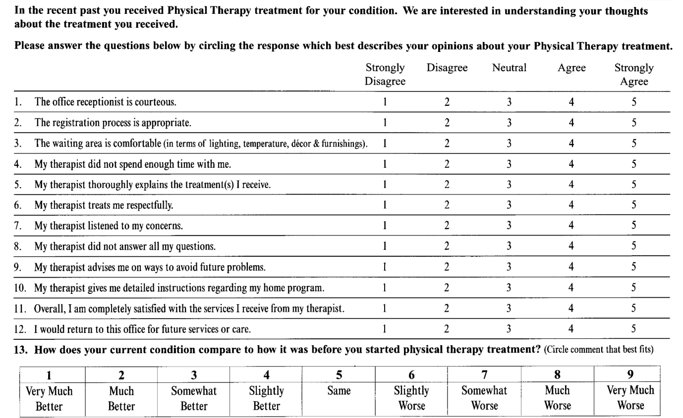
MedRisk instrument
PARENT

Slide 9

MedRisk instrument
PARENT

Slide 10
PARENT
Methods
MedRisk instrument
parent-proxy, romanian-language

Slide 11
PARENT
Target group
n=24 parents
convenience sample
Starting 2nd March 2024
online survey
Notes:
Terminat tratament, varsta
Who how many when where

Slide 12
PARENT
Results
descriptive and inferential statistics

Slide 13
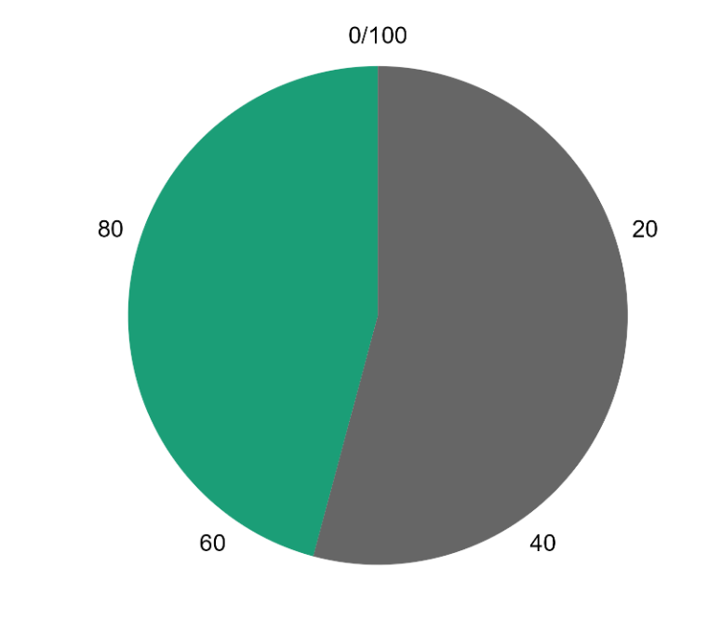
Descriptive analysis
PARENT
13 M
11 F
Notes:
Gender – more males than females

Slide 14
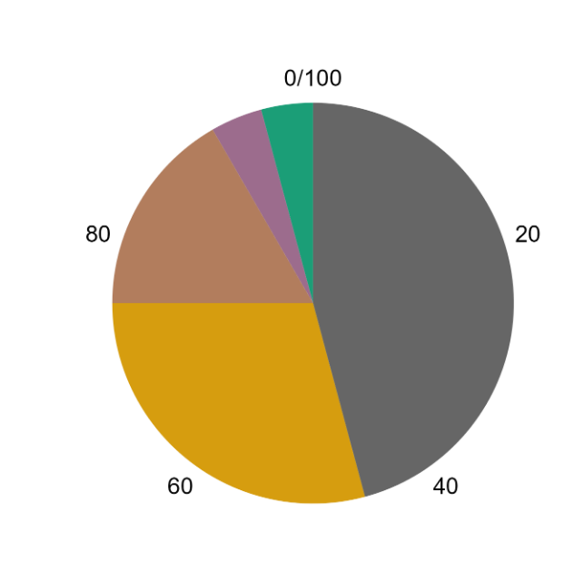
Descriptive analysis
PARENT
1 Infant (28d – 12 mo)
1 Toddler (13 mo – 2y)
4 Early childhood (2 – 5y)
7 Middle childhood (6 – 11y)
11 Early adolescence (12 – 18y)
(Williams et al., 2012)
Notes:
Gender – more males than females

Slide 15
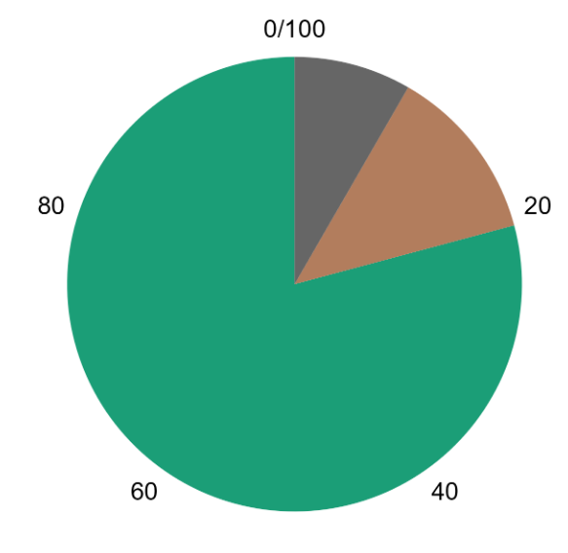
Descriptive analysis
PARENT
19 completed
3 still in treatment
2 did not complete
Notes:
Gender – more males than females

Slide 16
3 External Factors
PARENT
(Beattie et al., 2005)

Slide 17
7 Internal Factors
PARENT
(Beattie et al., 2005)

Slide 18
Descriptive statistics
PARENT
 | External Factors | Internal Factors
Mean | 4.611 | 4.733
Std. Error of Mean | 0.098 | 0.075
Std. Deviation | 0.478 | 0.367
Minimum | 3.667 | 3.800
Maximum | 5.000 | 5.000
Notes:
Moderate Reliability: The internal factors (therapist-related questions) and external factors (administrative-related questions) have moderate consistency. This means that the questions within each category are somewhat consistent in what they measure, but there's room for improvement.
Moderate Error: There is a moderate amount of error in the satisfaction scores, meaning the true satisfaction level might slightly vary if we repeated the survey. This suggests that while the measurements are reasonably accurate, they are not perfect.

Slide 19
Overall satisfaction
PARENT

Slide 20
Willingness to Return
PARENT

Slide 21
Correlations
PARENT
 |  |  | Pearson's r | p
Average EF | - | Overall satisfaction | 0.425 | 0.039
Average EF | - | Willingness to return | 0.684 | < .001
 |  |  | Pearson's r | p
Average IF | - | Overall satisfaction | 0.415 | 0.044
Average IF | - | Willingness to return | 0.491 | 0.015

Slide 22
PARENT
Communication is not enough
waiting room and registration

Slide 23
PARENT
Overall satisfied
Romanian parents

Slide 24

PARENT
Future work
MedRisk parent proxy
more data

Slide 25
PARENT
Parental Attitudes Regarding Exercise and Neuromuscular Therapy - The Adapted Version of the MedRisk Instrument for Measuring Parental Satisfaction with Physical Therapy Services
21 mai 2024
Cherecheș Ștefania, FEFS, KMS, anul II
Coordonator Lect. Dr. Bulduș Codruța Florina
cherechesstefania@gmail.com
Notes:
PARENT - Parental Attitudes Regarding Exercise and Neuromuscular Therapy

