Slide 1
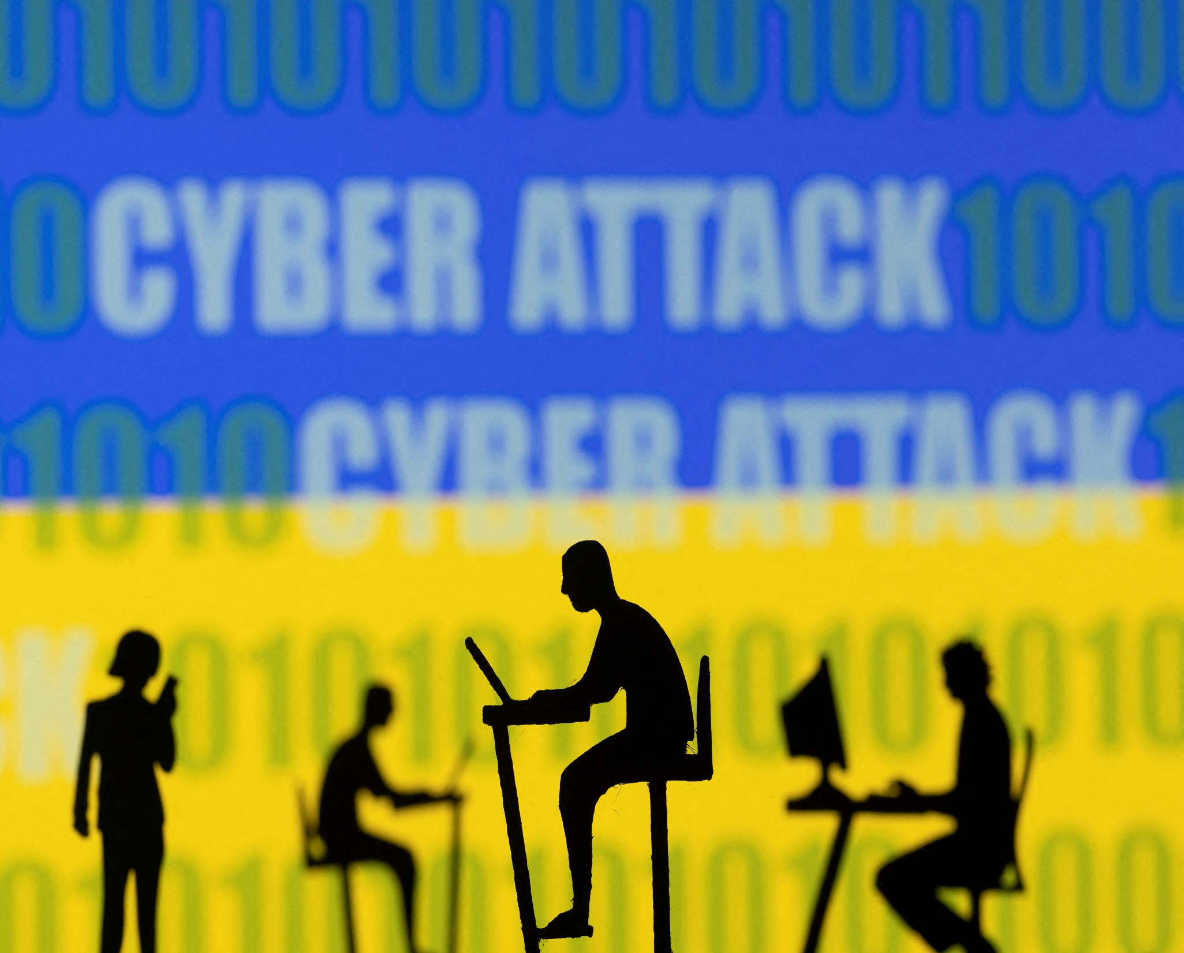
From Legislation to Practice:
Understanding Cybersecurity
Through Policy Insights
Irina Groza(Mocrac)
irina.groza@ubbcluj.ro
Babes-Bolyai University , Cluj-Napoca ( Romania )
Department of Mathematics and Informatics
Doctoral Student

Slide 2
Key words: cyber security, legislation, Ukrainian-Russian syber war.
Abstract: The legislative framework pertaining to cybersecurity in Russia lacks comprehensive public documentation, while Ukraine provides transparent access to its strategic plans for cybersecurity development. This article presents an analysis of the Ukrainian cybersecurity roadmap for 2023-2024 and the perspectives of Russian experts on the concept of import substitution in cybersecurity. By examining Ukrainian initiatives and Russian viewpoints, the article aims to shed light on the differing approaches to cybersecurity governance and policy implementation in these neighboring nations.

Slide 3
Cyberspace Dynamics: Neologism Evolution in the Ukraine-Russia Cyber Conflict
The process of a word entering a dictionary
Neologisms gain different interpretations in English, Ukrainian, and Russian and have different word statuses. Cyberspace vocabulary needs to be determined separately per each word apart in every language. Today, IT notions are coined in the dimension of the first cyber war, where Ukraine is fighting against Russia.
Neologisms gain different interpretations in English, Ukrainian, and Russian and have different word statuses. Cyberspace vocabulary needs to be determined separately per each word apart in every language. Today, IT notions are coined in the dimension of the first cyber war, where Ukraine is fighting against Russia.
Outlining
a process.
Defining a concept in official documentation.
Identifying a term with an official definition.
Introducing a term into other languages.
Adding the new word to dictionaries.

Slide 4
Disparity in defining the subject
Meanwhile, the former Federal Agency for Government Communications and Information employee A. Masalovich (Cyberded) in his interview says cyberspace is not defined in any legislative act at the international level. The Americans and the British are “torpedoing” a single cyberspace, where the political, physical, and technical domains are simultaneously located, while the Russian approach separates the information space and cyberspace
The information space &
A cyberspace.
Russia
One Cyberspace
UE
Ukraine

Slide 5
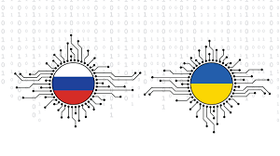
The ethical part of “cyber” hasn`t been ironed out. There is no universal understanding of what is okay in “cyber” and what is not. I think as the war goes on, those conversations will become more “stark” because now we see an action, we have not seen before. It was more a possibility than it was a reality. That`s changing the conversation a lot.

Slide 6
2. Cybersecurity Legislation: Contrasting Strategies in Ukraine and Russia
Ukrainian | Date | Russian | Date
The law about the main principles of ensuring cyber security of Ukraine | 05.10.2017 | Federal Law on safety critical information infrastructure Russian Federation | 02.07.2013
The procedure for conducting a cybersecurity assessment of critical information infrastructure, state information resources, and information whose protection requirements are established by law. | 11.11 2020 | Decree of the President of the Russian Federation on additional measures to ensure information security of the Russian Federation | 01.05.2022
- Plan measures for 2023-2024 to implement the Cyber ​​Security Strategy of Ukraine - Indicators of the implementation of the cyber security strategy of Ukraine | 19.12.2023
The documents formulating Ukraine's cyber security legal framework encompass regulations, laws, orders, and resolutions: The law about the main principles of ensuring cyber security of Ukraine, Indicators of implementation of the cyber security strategy of Ukraine, Plan measures for 2023-2024 to implement the Cyber ​​Security Strategy of Ukraine, etc. At the same time, the regulation (EU, Euratom) 2023/2841 of the European Parliament and of the Council of 13 December 2023 defines new frontiers for Ukrainian legislation.

Slide 7
The Sources of Concept Evolution in Cybersecurity
A
B
C
Concepts in Cybersecurity
D
GREY ZONE
The figure includes the documents mentioned in the Russian manual of cybersecurity for Russian schoolchildren. If points A, B, and C are strongly related to each other, how is the lack of connection with point D explained to students? Is it possible to empathetically analyze the process in triangle ACD? If not, then why? We have to find a scientific explanation.
A General Assembly Resolution United Nations A/RES/57/239
B European Convention on Cybercrime (crimes in cyberspace) Budapest, November 23, 2001
The law about the main principles of ensuring cyber security of Ukraine
C The law about the main principles of ensuring cyber security of Ukraine
E The Concept on Cybersecurity
D The Federal Law on Information, information technology,and oinformation protection

Slide 8
EU and Ukrainian Cybersecurity Laws
European legislation on cybersecurity | Ukrainian legislation on cybersecurity
-Regulation(EU) 2019/881on ENISA and on information and communications technology cybersecurity certification --Regulation (EU, Euratom) 2023/2841 laying down measures for a high common level of cybersecurity at the institutions, bodies, offices and agencies of the Union | ­- The law about the main principles of ensuring cyber security of Ukraine - Plan measures for 2023-2024 to implement the Cyber ​​Security Strategy of Ukraine - Indicators of the implementation of the cyber security strategy of Ukraine

Slide 9
3. Analyzing Ukraine's Cyber Defense Strategy: Perspectives Beyond Official Documents
Goals Derived from Ukrainian Laws Potentially Influencing New Cybersecurity Concepts
Goal 1 | Aims to develop a system of cybersecurity indicators, including basic cybersecurity status indicators, indicators of national cybersecurity system development, and indicators of critical information infrastructure protection.
Goal 4 | aims to enhance asymmetric deterrence instruments by : - establishing legislative frameworks to engage private sector and civil society in cyber defense.
Goal 2 | to enhance Ukraine's capability to counteract espionage and cyber-terrorism. For that: - to establish a nationwide system for detecting cyberattacks.
Goal.5 | aims to enhance Ukraine's cyber preparedness and security through several key initiatives. These include: - developing a national response plan for cyber emergencies, - establishing a national incident management system, - setting minimum security standards for both public and private sectors .
Goal 3 | aims to enhance cybercrime prevention in Ukraine through several key strategies. These include: - developing conceptual approaches to safeguard citizens' rights in cyberspace. - establishing methods for collecting cybercrime statistics, and facilitating communication between the government and society to counter large-scale cyberattacks. Furthermore, it seeks to regulate the legal status of cryptocurrencies.
Goal 6 | aims to enhance professional skills, cyber literacy, and scientific-technical support for cybersecurity. It involves : -stimulating research considering emerging technologies like cloud, quantum computing,etc. - developing a national cyber literacy program.

Slide 10
4.The Virtual Front: Ukraine and Russia's Cyber Struggle
President of the European Association of Software Engineering V. Savchenko says: In Ukraine, there are up to tens of thousands of cyberattacks per year. The active phase began in September 2021 on the systems of authorities and military facilities. Russia tried to break the registries. After all, we are dealing with the first cyber war of states in history crossed with information warfare.[19] R. Vityuk Head of the SBU Department underlines that the world's first full-fledged cyber war is underway. It can be considered as a separate dimension of this war.[20] Today there is a whole network of applications, where you can enable your computer or phone to automatically work for our victory.”

Slide 11
Let us follow the changes in Fedorov`s ideas basing on officially posted interviews.
2024.03 A lot depends on the law on mobilization that will be adopted how it will develop mobilization in the direction of digitalization [27].
2024.02.The bases themselves do not burn [28].Russia must understand that we have only just begun [29].
2024.01.Today there are more than 200 private enterprises that are engaged in the production of BLO. At the beginning of the war there were only 7 authorized in the country [30]
.2023.12. “Our logic is that we rank services with the largest number of users and digitize them. We respond to problems that arise. For example, payments for evacuation.” [31]
2023.11. “We are developing a state strategy which we will present in December. The strategy also describes sectors. One of the sectors is the chip industry. We plan to develop an act chip.” [32]
2023.11. We have created the Brain 1 cluster for those who have a military idea that needs funding.
It is possible to set up a call with the General Staff. More than 700 applications have already been submitted. More than a million euros have been received in grants. Next year funding will increase significantly [33]
.2023.10. “A digital office was launched, a new service for government authorities, Diya Engine, which plans to save millions of hryvnias of state money [34].
At the beginning of the war, the Ukrainian mass-media reported more about the successes of the haktivists compared to the last year of the war.
In any case, there is a direct connection between the legally enshrined concept, the words of the Deputy Prime Minister and the expressed opinions

Slide 12
Ukrainian hackers hacked CCTV cameras in seven Russian cities, including Moscow,
and forced them to listen to the Ukrainian anthem on Independence Day [35]
As reported by the Main Directorate of Defense Mines Intelligence of Ukraine, on Navy Day,
Russian sailors received a message containing a Trojan virus that redirected personal data from their phones to Ukrainian servers. [36]
A satellite television provider in Novosibirsk was hacked and a video message was launched with a proposal to lay down arms [37].
The databases of Russian business giants were destroyed. The “overcloud.ru“ cloud server contained data from more than 10
thousand legal entities. Hackers destroyed the data center.
This was a joint operation of the” Black Jack” group with the cyber department of the SBU [38]
5. One of the largest banks in Russia, Gazprombank, was attacked. The only bank that escaped Western sanctions. Gazprombank itself admitted
this at the Russian cybersecurity summit [39].
Ukrainian hacktivists do not simply follow instructions. Instead, they actively engage as independent members of the process.
Their motivation comes from within; they aren't coerced or pushed into action.
This observation stems from numerous reports and interviews.

Slide 13
5. Exploring the Landscape: Russian SIEM Solutions and Cyber Threat Resilience
Russian Products for Cybersecurity Available on the Current Marke
 | Name | Features | Certificates
1 | Alertix Question | Analyst notepad; Sysmon and Beats configuration management; flexible control of the depth of storage and archiving of events from sources; How do Russian cybersecurity experts set up Sysmon and Beats to protect systems, considering local regulations and regional threats? | FSTEC certificate
2 | Ankey SIEM NG | automated information security monitoring and continuous monitoring of changes in the organization’s IT infrastructure; automated detection of known vulnerabilities in asset software; identifying incidents among a large number of information security events; detecting failures in the operation of IT and information security systems and responding to them.
3 | Kaspersky | ecosystem (functional integration with other Kaspersky products), RESTful API, ability to interact with response platforms (IRP and SOAR); automation of routine actions to respond, host inventory, enrich information security events with context; performance of more than 500 thousand EPS, tested on the customer’s real architecture; minimum system requirements and flexible horizontal scalability, support for geographically distributed installation, high availability and multi-tenancy modes; How prevalent are RESTful APIs in Russian tech, and which sectors or companies use it most? | FSTEC certificate

Slide 14
6.Cybersecurity in Schools: Balancing Accessibility with Protection in the Digital Age
Comparative analysis of Ukrainian and Russian studying programs on cybersecurity for schoolchildren.
 | Features | Ukraine | Russia
1 | Legislative base | “improving training systems for cybersecurity professionals and developing a national cyber literacy program.” | The federal law “On the protection of children from information that causes harm their health and development
2 | Title Active users | Основи кiбербезпеки для школярів 25333 | Основы кибербезопасности No information found
3 | Target age groups | 4 ( for children 6-11 years) | 1 ( for children 12-17 years)
4 | Creator | CRDFGLOBAL СМАРТОСВIТА | Российский учебник Author S.Vanagarodskii
5 | Registration | Only Ukrainian schoolchildren | Manual is found in an open source
6 | Description | Attractive for children, Explains clearly goals and content, Well structured for every age group | The most part of the manual represents short version of the laws,no pictures, no attractive content
7 | Source Webpage | https://cyberkidsukraine.org/ | Основы-кибербезопасности.pdf (iro23.ru) no

Slide 15
References:
[1]. Wikihedia Информационная структура [Online] Available: Информационная инфраструктура [ Accessed Apr. 10 2024]
[2] Українська бібліотечна енциклопедія. [Online]. Available: nlu.org.ua [Accessed Apr.10, 2024]
[3] Oxford dictionary [Online] Available: cybersecurity noun - Definition, pictures, pronunciation and usage notes | Oxford Advanced Learner's Dictionary at OxfordLearnersDictionaries.com [Accessed Apr.10, 2024]
[4] Українська бібліотечна енциклопедія. [Online]. Available: nlu.org.ua [Accessed Apr.10, 2024]
[5] Oxford dictionary [Online] Available: hacktivist noun - Definition, pictures, pronunciation and usage notes | Oxford Advanced Learner's Dictionary at OxfordLearnersDictionaries.com [Accessed Apr.12, 2024]
[6] Міноборони ініціювало роботу над законодавчим визначенням поняття «кібервійна». [Online]. Available: mil.gov.ua [Accessed Apr.15, 2024]
[7], [8] "Кибер-война между странами. Будущее наступило вчера". [Online]. Available: youtube.com
[Accessed Apr.17, 2024]
[9] "Regulation (EU) 2019/881 of the European Parliament and of the Council of 17 April 2019 on ENISA (the European Union Agency for Cybersecurity) and on information and communications technology cybersecurity certification and repealing Regulation (EU) No 526/2013 (Cybersecurity Act)," [Online]
Available: Regulation - 2019/881 - EN - EUR-Lex (europa.eu) [Accessed Apr.17, 2024]
[10] Anonymos [Online] Available : youtube.com [Accessed Apr.19, 2024]
[11] ,[12] "Regulation (EU) 2019/881 of the European Parliament and of the Council of 17 April 2019 on ENISA (the European Union Agency for Cybersecurity) and on information and communications technology cybersecurity certification and repealing Regulation (EU) No 526/2013 (Cybersecurity Act)," [Online] Available: Regulation - 2019/881 - EN - EUR-Lex (europa.eu) [Accessed Apr.18, 2024]
[13],[14],[15],[16],[17] GPT chat [Accessed Apr.20, 2024]
[18] Plan measures for 2023-2024 to implement the Cyber ​​Security Strategy of Ukraine Available: Про затвердження плану заходів на 2023—2024 роки з реалізації Стратегії кібербезпеки України | Кабінет Міністрів України (kmu.gov.ua) [Accessed Apr.10, 2024]
[19],[20],[21],[22],[23],[24],[25],[26] ПЕРЕИГРАЛ ФСБ! Хакер взломал криптокошельки ФСБшников и передал деньги на нужды ВСУ". [Online]. Available: youtube.com [Accessed Apr.9, 2024]

Slide 16
[27] "ФЕДОРОВ про електронні повістки, дрони та Маска". [Online]. Available: youtube.com [Accessed Apr.9, 2024]
[28],[29] "Російські кораблі тонуть, а нафтобази вибухають: Михайло Федоров про результати Армії дронів". [Online]. Available: youtube.com [Accessed Apr.8, 2024]
[30] "Інновації, які змінюють хід війни: Михайло Федоров про дрони, РЕБ та Brave1 | Подкаст Слон". [Online]. Available: youtube.com [Accessed Apr.8, 2024]
[31] "Як керувати 40+ проєктами, де шукати лідерів у команду та нові послуги на Diia Summit | Подкаст Слон". [Online]. Available: youtube.com [Accessed Apr.19, 2024]
[32 ]Виробництво чипів, стратегія інновацій та капіталізація defence-tech в Україні | Подкаст Слон". [Online]. Available: youtube.com [Accessed Apr.19, 2024]
[33] "Михайло Федоров – про дрони, Маска, мобілізацію, Дію і Telegram". [Online]. Available: youtube.com [Accessed Apr.19, 2024]
[34] "Розвиток цифрової держави || Михайло Федоров". [Online]. Available: youtube.com[Accessed Apr.9, 2024]
[35] "Звучал гимн Украины: хакеры взломали видеокамеры со звуком в России". [Online]. Available: youtube.com [Accessed Apr.9, 2024]
[36] "Подарочек ко дню ВМС РФ: украинские хакеры атаковали вирусом телефоны росссийских моряков". [Online]. Available: youtube.com [Accessed Apr.19, 2024]
[37] "Українські хакери запустили на телебаченні рф звернення ЗСУ до російських солдатів". [Online]. Available: youtube.com [Accessed Apr.20, 2024]
[38] "НПЗ КОНЕЦ! Украинские хакеры уничтожили базы данных: Лукойл, Газпром, Роснефть, Мегафон | В ТРЕНДЕ". [Online]. Available: youtube.com [Accessed Apr.20, 2024]
[39]"Украинские хакеры взломали 'Газпромбанк'". [Online]. Available: youtube.com [Accessed Apr.9, 2024]
[40],[41] "Обзор российского рынка SIEM-систем 2024". [Online]. Available: anti-malware.ru [Accessed Apr.9, 2024]
[42],[43] GPT chat
[44] "Обзор российского рынка SIEM-систем 2024". [Online]. Available: anti-malware.ru [Accessed Apr.19, 2024]
[45].[46] "XDR — маркетинг, концепция или реальный продукт?". [Online]. Available: anti-malware.ru[Accessed Apr.19, 2024]
[47],[48],[49],[50] АГРЕГАТНОЕ СОСТОЯНИЕ КИБЕРПРОСТРАНСТВА: IT-ПРОТИВОСТОЯНИЕ – ОТ СУПЕРТЕХНОЛОГИЙ ДО КОМПЬЮТЕРНЫХ ИГР [Online] Available: youtube.com[Accessed Apr.9, 2024]
[51] Открытые Киберспортивные Игры 2023 [Online]. Available: resfopen.ru [Accessed Apr.20, 2024]
[52],[53] "Regulation (EU) 2019/881 of the European Parliament and of the Council of 17 April 2019 on ENISA (the European Union Agency for Cybersecurity) and on information and communications technology cybersecurity certification and repealing Regulation (EU) No 526/2013 (Cybersecurity Act)," [Online] Available: Regulation - 2019/881 - EN - EUR-Lex (europa.eu) [Accessed Apr.17, 2024]

