Slide 1
Optimizing Language Models for Real-Time Financial Conversations
Author/s: Andrei Ghiurțu, Olaru Karina, Băicoianu Alexandra
Affiliation: Transilvania University of Brașov

Slide 2
Objectives
Adapting a Conversational Language Model for Financial Purposes
Optimizing the Solution to run on Resource-Limited Devices

Slide 3
Pipeline

Slide 4
Vector Database (1)
The context for creating responses is made up of multiple articles, which are updated daily. The following APIs are used:
News API
FinnHub
These are stored in a Qdrant vector database

Slide 5
Vector Database (2)

Slide 6
Reranking Mechanism (1)
After the user submits a question, the RAG mechanism is initiated:
With the help of a Bi-Encoder, the closest contexts are obtained.
However, there is no certainty that they are relevant for the answer.

Slide 7
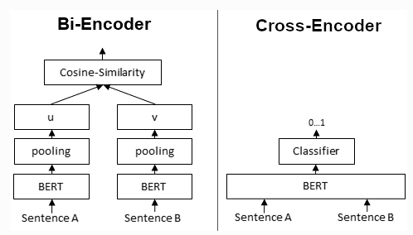
Reranking Mechanism (2)
To maximize the retrieval accuracy, a reranking mechanism is added to the pipeline.
A key role is played by the Cross-Encoder, based on BERT, which has been fine-tuned on a synthetic dataset.

Slide 8
Reranking Mechanism (3)

Slide 9
Generative Language Model (1)
The generative language model used was Qwen1.5-0.5B-Chat. The decision was influenced by the following requirements:
Running on a wide range of mobile devices
The model's capacity to retain as much information from conversations as possible
For training, 200 examples generated via GPT-3 were used, helping the model replicate the responses of a considerably larger model.

Slide 10
Generative Language Model (2)

Slide 11
Toxicity and Hallucination Detection
The toxicity detection model assigns a score for different categories of toxicity.
Any score higher than T = 0.7 leads to the message being overwritten.
Similarly, the hallucination model provides a similarity score between the context, question, and answer.
A score higher than T = 0.7 will lead to the addition of a message informing the user that the answer might not be factually correct based on the context retrieved or related to the question.

Slide 12
Optimizing the Language Model Through Various Techniques (1)
Passthrough, or Depth Up-Scaling
A technique of combining certain layers from multiple models.
Although this results in a larger model, the performance is better.

Slide 13
Optimizing the Language Model Through Various Techniques (2)

Slide 14
Optimizing the Language Model Through Various Techniques (3)
TIES is a technique of merging multiple models
Each model is specialized in certain tasks, thus creating a multi-tasking final model.
For this purpose, only the most significant parameters are retained, while the importance of the others is nullified.

Slide 15
Optimizing the Language Model Through Various Techniques (4)
The second technique, DARE, combines the following functionalities:
TIES
Pruning: Randomly sets some weights to those of the initial model
Rescaling: Combines the initial weights with the new weights, adding a scaling factor

Slide 16
Optimizing the Language Model Through Various Techniques (5)
Author: Maxime Labonne

Slide 17
Optimizing the Language Model Through Various Techniques (6)

Slide 18
Performance Metrics
Model | Business Ethics | Econo-metrics | Macro- economics | Micro- economics | Juri-prudence | Accounting | Professional Law
Qwen 1.5-0.5B-Chat | 39.00 | 21.92 | 25.12 | 31.93 | 41.66 | 26.59 | 29.33
Qwen 1.5-0.5B-Chat FinancialQA | 38.00 | 23.68 8% | 26.15 4% | 33.19 4% | 38.89 | 30.14 13% | 29.34
Our solution + DARE | 37.00 | 23.68 8% | 25.90 | 32.77 | 39.81 | 30.14 13% | 29.66 1%
Our solution + PT | 32.00 | 23.68 8% | 21.03 | 24.79 | 36.11 | 25.18 | 28.36

Slide 19
Q&A

