Slide 1
Fluoride Metal Complexes. Synthesis and Structural Analysis.
Strugurel Stănescu
University of Bucharest, Faculty of Chemistry, Bucharest, Romania

Slide 2
Fluoride Metal Complexes.
Fluoride transitional metal ion complexes have several applications in catalysis, material science, due to their unique properties and reactivity. In this work we present the synthesis and structural analysis of two fluoro-manganese (III) complexes obtained with hydrogen difluoride ion, a special fluorinating agent. The compounds show a combination of strong hydrogen bonds (as provided by HF₂⁻) and coordinative covalent bonds. Understanding the coordination chemistry of fluoride transition metal complexes helps in elucidating fundamental principles of coordination chemistry and metal-ligand interactions, contributing to the development of new coordination compounds with tailored properties.

Slide 3



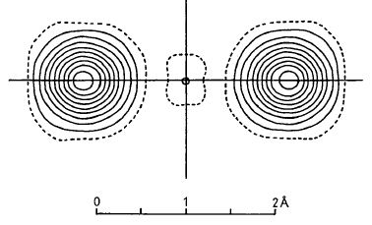
[HF₂]⁻ is the most simple coordination compound or a compound with the strongest hydrogen bond?
covalent
ionic
Both conceptions are hard to be separated
Hydrogen bond characteristics
Compound | Bond | Bond distance,Å | Bond energy, kcal
H₂O | O-H···O | 2.85 | 4.5
(HF)_{n} gas | F-H···F | 2.55 | 6.7
KHF₂ | F-H···F | 2.26 | 58
(a)
(b)
(c)
(a) and (c) structures with the same degree of participation
If (a) and (c) have a different contribution then an asymmetrical hydrogen bound appear
Electron density in the [FHF]⁻ ion at room temperature
Structural analysis of [HF₂]⁻
X ray diffraction, neutron diffraction and electron density

Slide 4
[HF₂]⁻ as special fluorinating agent
Synthesis against HSAB factors.
Elective afinities in coordination?!
-avoid the using of HF;
-afford elimination of one acidic proton and of one fluoride ion
2 MMe₃ + [n-Bu₄N][HF₂] [n-Bu₄N][Me₂MF₂] + MeH
THF, tºC
M = Al, Ga, In
Ferbinteanu, M. et al. Inorg. Chem. 2001, 40, 4947-4955.
From organometallic chemistry to coordination chemistry
CH₃CN
Mn(CH₃COO)₃ + [Ph₄P][HF₂] + 1,10-phen
1D-[Mn(1,10-phen)F₂(HF₂)] (1)
50-60°C
Spinu, C. Dissertation Thesis, University of Bucharest
MeOH
[Mn(salen)(H₂O)](ClO₄) + K[HF₂]
1D-[Mn(salen)F] (2)
50-60°C

Slide 5
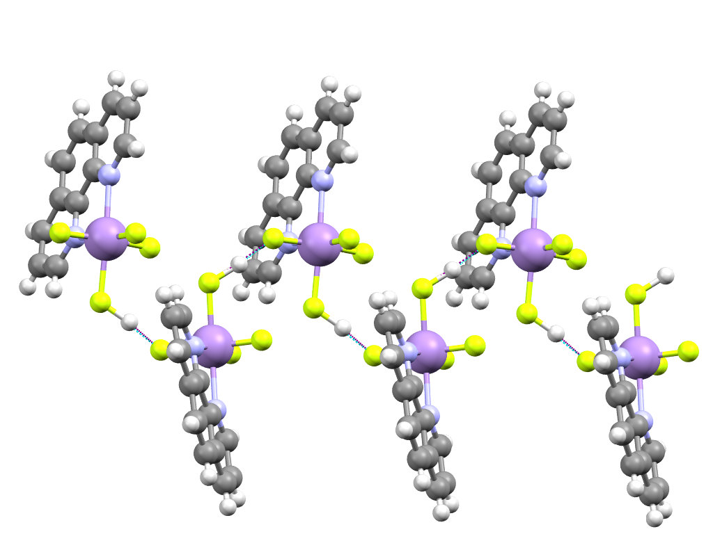
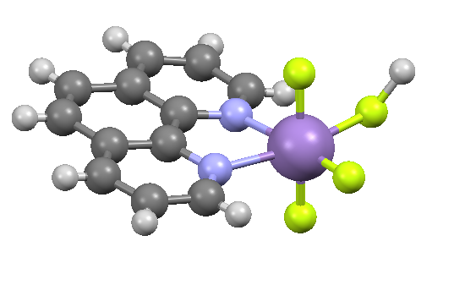
(1) –Single crystal X-ray diffraction analysis
F4
N2
F1
Mn1
N1
F3
F2
Asymmetric units for [Mn(phen)F₂(HF₂)]
F1
Crystallographic Data summary
H
Empirical Formula C₁₂H₉F₄MnN₂
Molecular weight 312.15 g/mol
Crystal Color, Habit brown, prism
Crystal System monoclinic
Space Group P2₁/c (#14)
Lattice Parameters a = 8.41510(10) Å
b = 7.38090(10) Å
c = 19.4205(5) Å
β = 102.1159(12) º
V = 1179.36(4) Å³
Z 4
Temperature 20 ºC
R1 (I>2.00s(I)) 0.0704
R (All reflections) 0.1105
wR2 (All reflections) 0.2689
Goodness of Fit Indicator 1.008
F2
Bond distance in the [HF₂]⁻ unit
F1-H 1.219 Å
H-F2 1.478Å
Comparing with KHF₂
2.26 Å

Slide 6
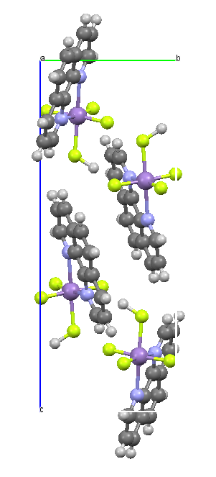
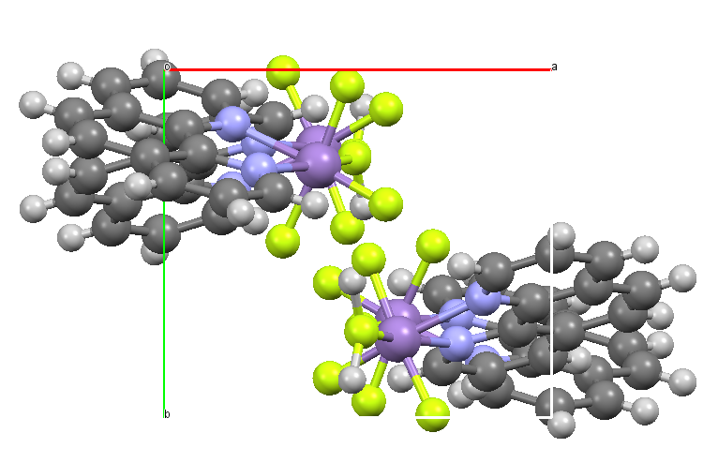
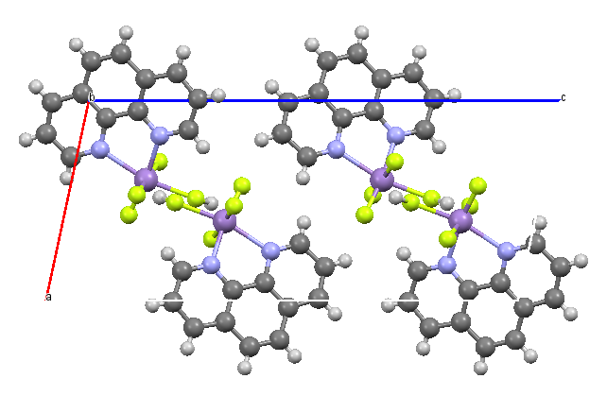
(1) –Single crystal X-ray diffraction analysis
a
b
c
Packing detail along a, b and c axis

Slide 7
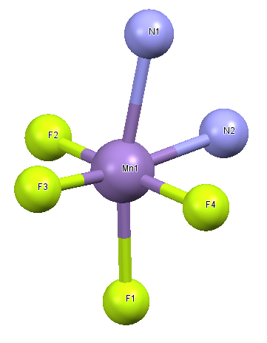
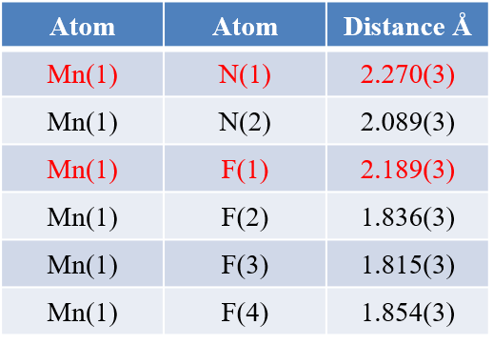
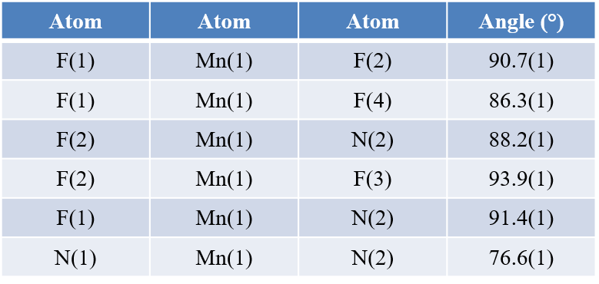
(1) a case of elongated octahedra in Mn(III) complexes
Selected bond lenghts (Å)
Selected bond angles(º)

Slide 8
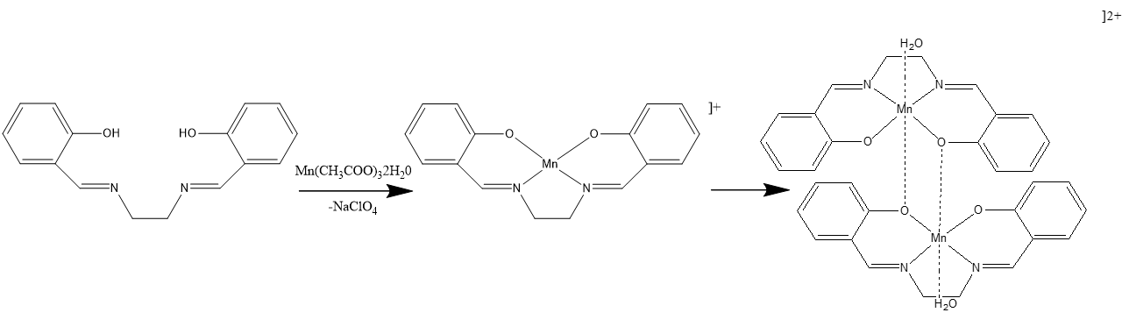
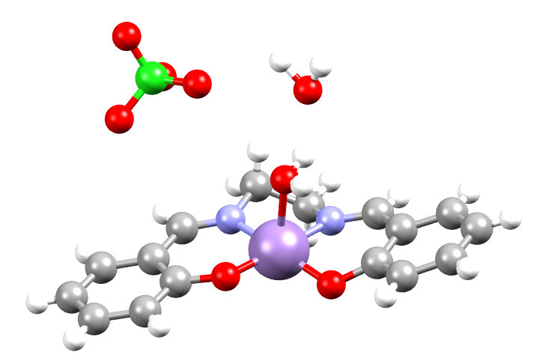
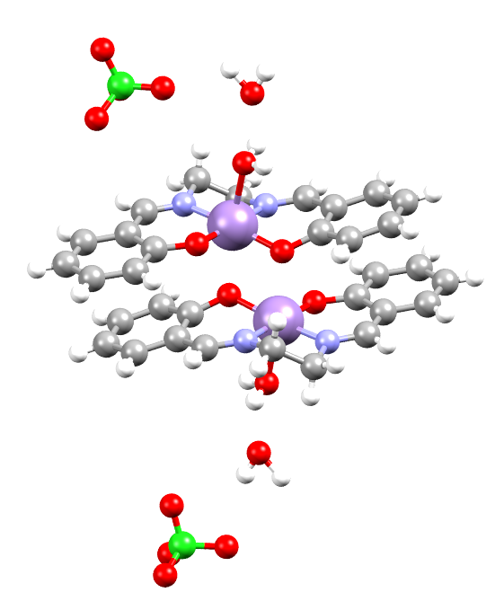
[Mn(salen)(H₂O)](ClO₄)– Synthesis and Single crystal X-ray diffraction analysis
Crystallographic Data summary
Empirical Formula C₁₆H₁₈ClMnN₂O₈
Molecular weight 456.71 g/mol
Crystal Color, Habit brown, prism
Crystal System monoclinic
Space Group P2₁/c (#14)
Lattice Parameters a = 7.2149(3)Å
b = 13.4128(5) Å
c = 19.4228(8) Å
β = 94.828(3)º
V = 1872.91Å³
Z 4
Temperature 20 ºC
R1 (I>2.00s(I)) 0.0429
R (All reflections) 0.0756
wR2 (All reflections) 0.0938
Goodness of Fit Indicator 1.089
Asymmetric unit for
[Mn(salen)(H₂O)](ClO₄)·H₂O

Slide 9
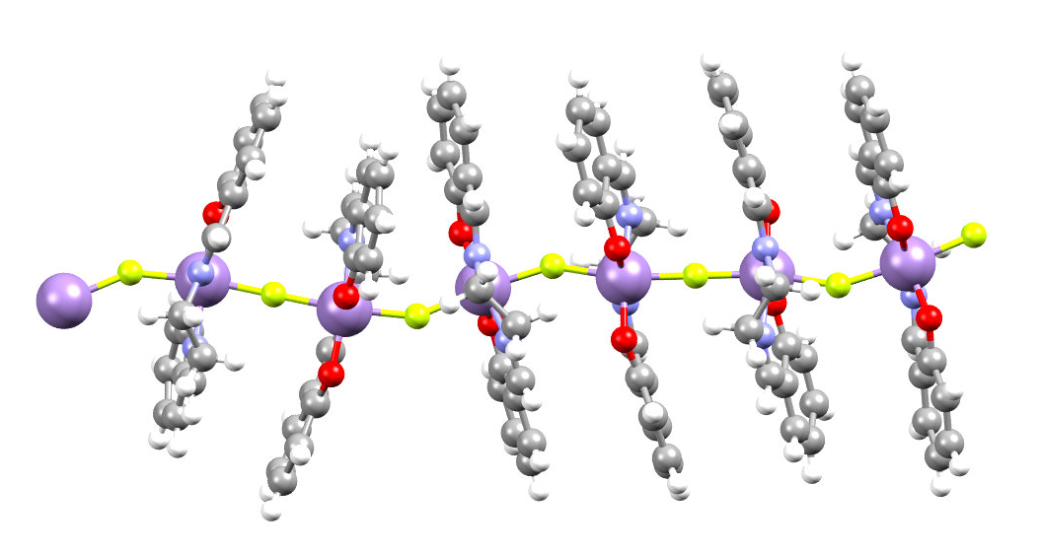
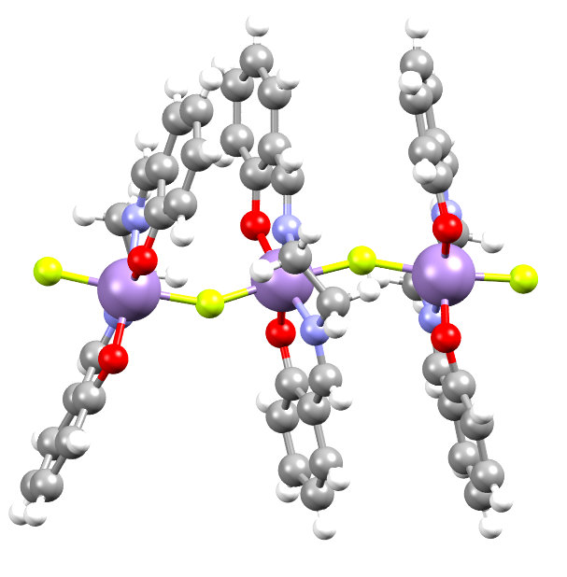
(2) –Single crystal X-ray diffraction analysis
F2
F3
F1
Mn3
F4
Mn1
Mn2
Crystallographic Data summary
Empirical Formula C₁₆H₁₄FMnN₂O₂
Molecular weight 340.237 g/mol
Crystal Color, Habit brown, prism
Crystal System triclinic
Space Group P-1
Lattice Parameters a = 10.0400(9) Å, b = 15.4490(12) Å, c = 16.0420(17) Å
α = 108.164(9)º, β = 103.874(10)º, γ = 101.140(7)º
V = 2196.3(3) Å³
Z 6
Temperature 20 ºC
R1 (I>2.00s(I)) 0.0384
R (All reflections) 0.0506
wR2 (All reflections) 0.0815
Goodness of Fit Indicator 1.015
1D-[Mn(salen)F] (2)
Similar compound reported in
Inorg. Chem. 2011, 50, 5312–5314,
obtained from MnF₃ and H₂salen

Slide 10
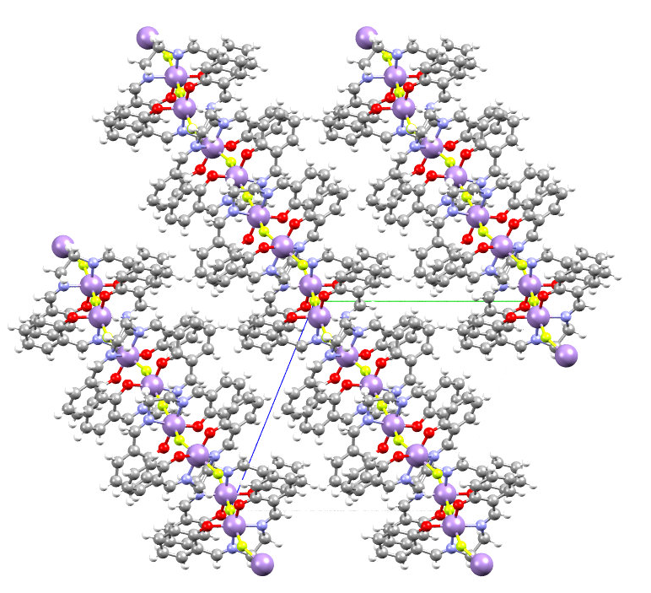
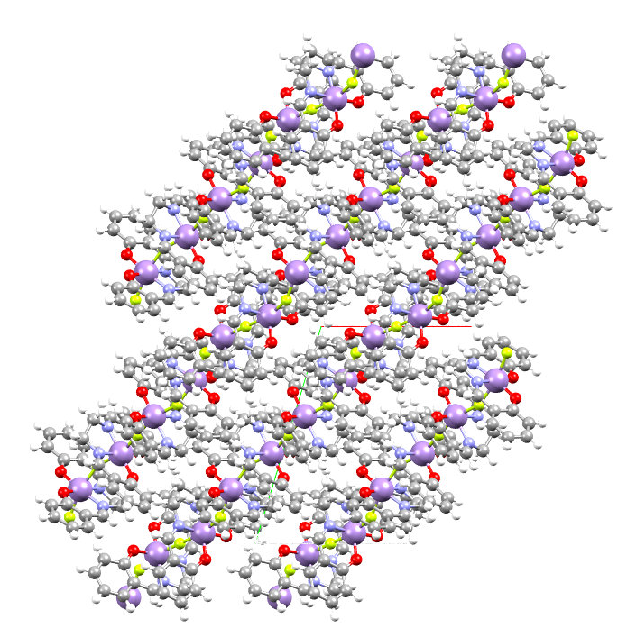
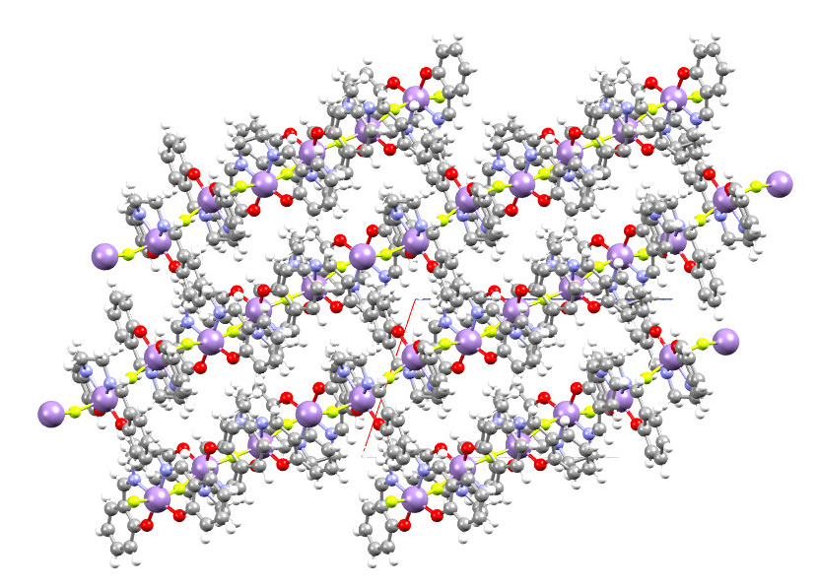
(2) –Single crystal X-ray diffraction analysis
a
c
b
Packing detail along a, b and c axis

Slide 11
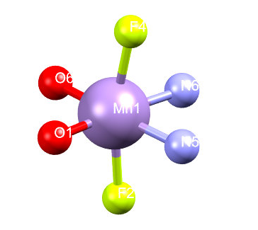
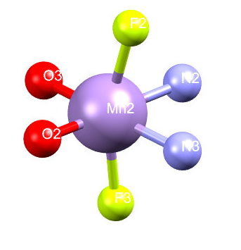
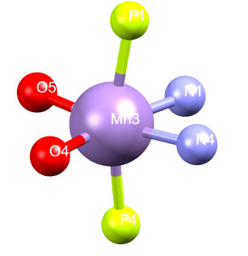
(2) a case of elongated octahedra in Mn(III) complexes
Selected bond lenghts (Å)
Atom | Atom | Distance, Å
Mn(1) | F(2) | 2.0790(7)
Mn(1) | F(4) | 2.0834(7)
Mn(1) | O(1) | 1.8926(9)
Mn(1) | O(6) | 1.9119(8)
Mn(1) | N(5) | 2.008(9)
Mn(1) | N(6) | 1.9949(9)
Atom | Atom | Distance, Å
Mn(2) | F(2) | 2.0915(8)
Mn(2) | F(3) | 2.0492
Mn(2) | O(2) | 1.8985(9)
Mn(2) | O(3) | 1.9044(8)
Mn(2) | N(2) | 1.9982(9)
Mn(2) | N(3) | 2.0059(9)
Atom | Atom | Distance, Å
Mn(3) | F(1) | 2.0956
Mn(3) | F(4) | 2.0829(8)
Mn(3) | O(4) | 1.8924(8)
Mn(3) | O(5) | 1.9044(8)
Mn(3) | N(4) | 2.0028(8)
Mn(3) | N(1) | 2.0000(8)

Slide 12
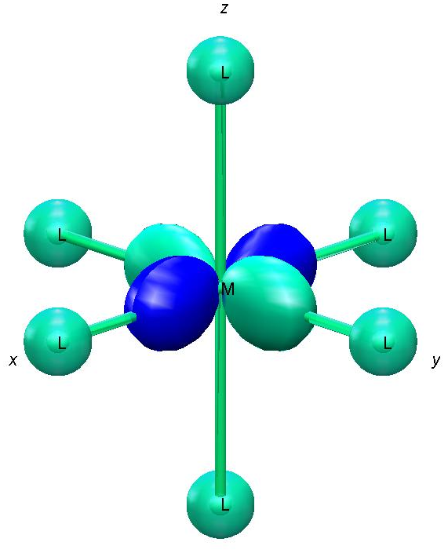
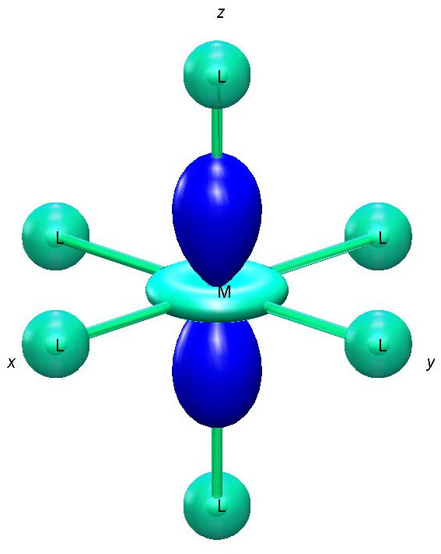
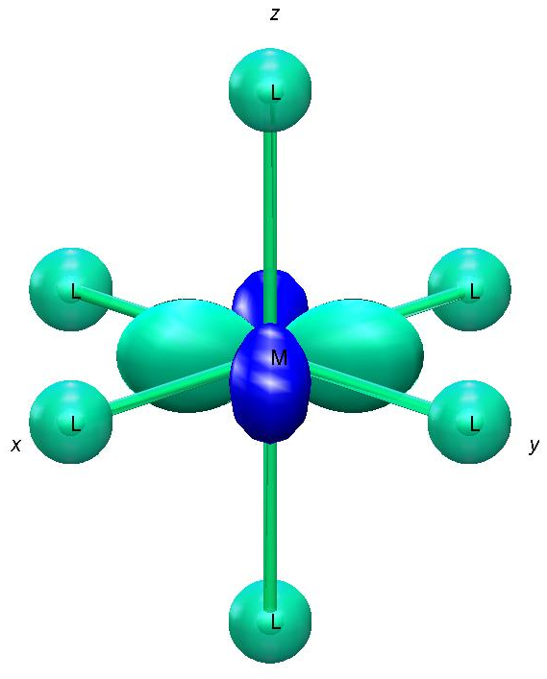
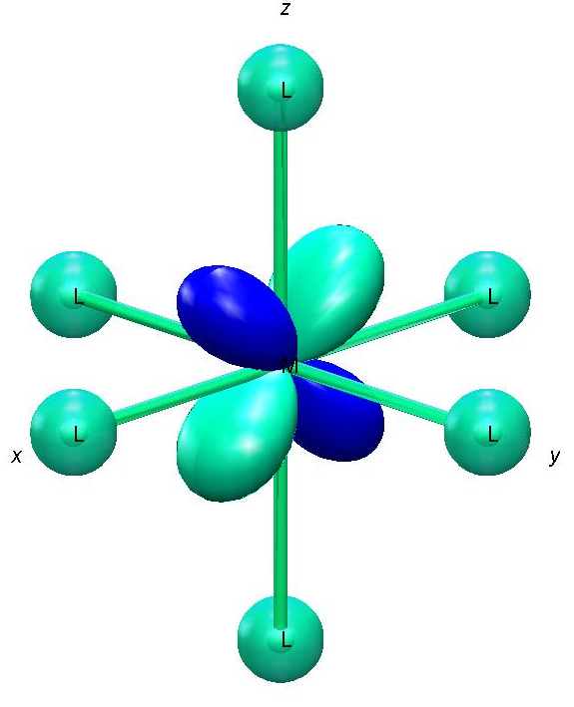
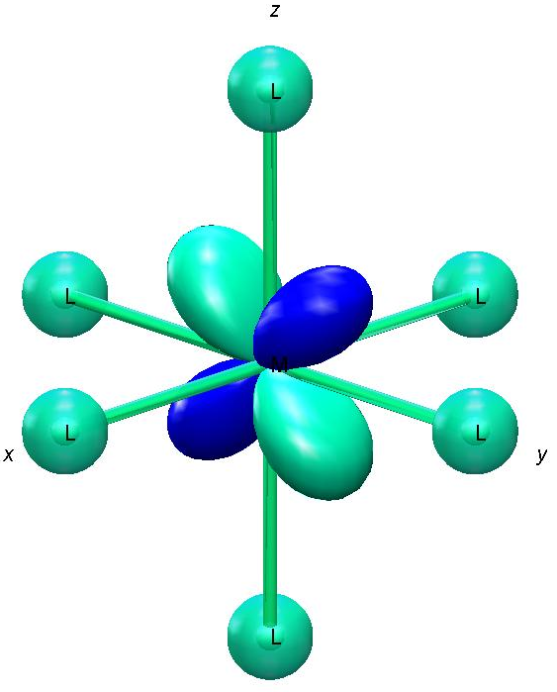
3
Anisotropy in elongated octahedra in Mn(III) complexes
Elongated
octahedron
b_{1g}
ORBITAL STATES
a_{1g}
The development of new coordination compounds with tailored magnetic properties.
b_{2g}
e_{g}
Weak Field Ligands
Weak Metal Interactions
High-Spin Complexes
B_{2g}
E_{g}
~10000 cm⁻¹
SPECTRAL TERMS
A_{1g}
~1 cm⁻¹
B_{1g}
The ground states are magnetic for Mn(III) complexes with an elongated octahedra geometry.
S_{z}=0
~1 cm⁻¹
S_{z}=±1
ZFS states
⁵B_{1g}
S_{z}=±2
D<0

Slide 13
Thank You!

