Slide 1
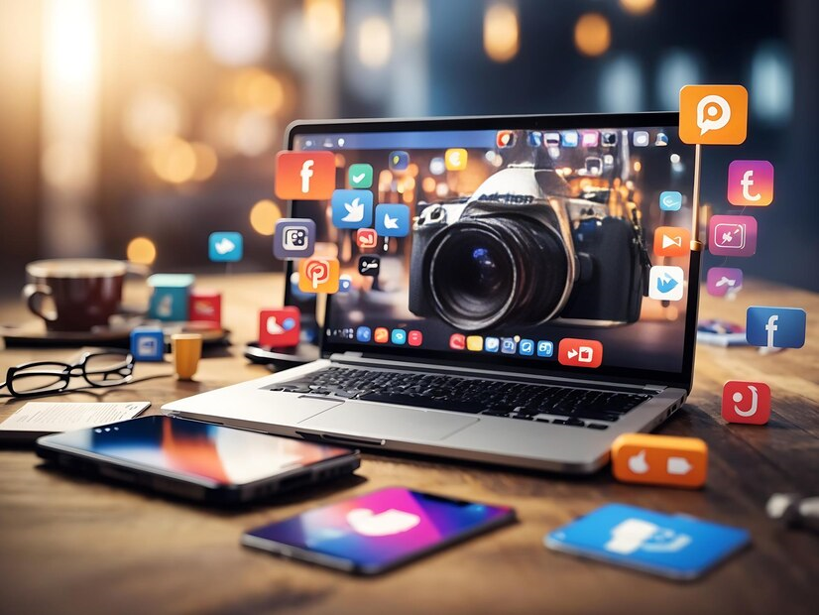

AI and Social Media: Marketing's New Frontier
Author: Ximena Barsan
Coordinator: Corina Pop Sitar
Affiliation: Economic sciences

Slide 2
Agenda
01
Digital marketing
02
Why social media marketing?
03
Artificial intelligence in digital marketing
04
Questionnaire results
05
Ethical considerations & conclusion

Slide 3
Digital marketing
Search Engine Optimization (SEO)
Email Marketing
Online Public Relations (PR)
Content Marketing
Affiliate Marketing
Conversion Rate Optimization (CRO)
Social Media Marketing
Influencer Marketing
Analytics and Data Analysis

Slide 4
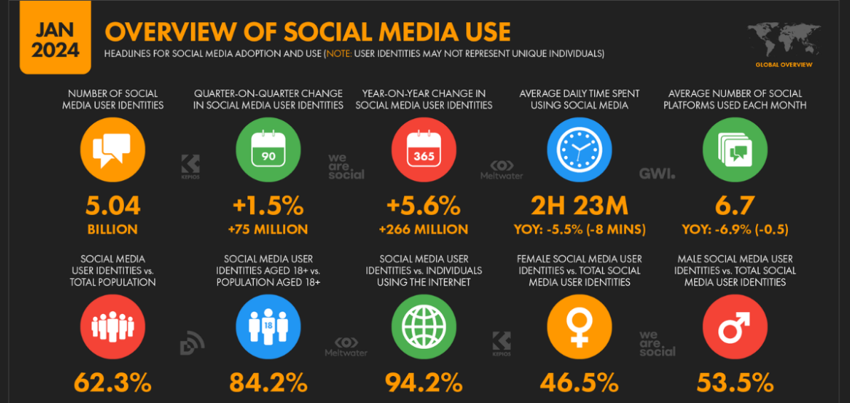
Why social media marketing?

Slide 5
AI in social media marketing
1
3
5
2
4
Content Optimization
Data-Driven Insights
Enhanced Customer Engagement
Targeted Advertising
Automating Routine Tasks

Slide 6
Uses of AI in social media marketing
Automated content generation
Content Creation and Curation
Content Curation
Targeted advertising
Personalization
Personalized content recommendations
Chatbots
Customer Service
Sentiment Analysis
Trend Analysis
Customer Service
Competitor Analysis

Slide 7
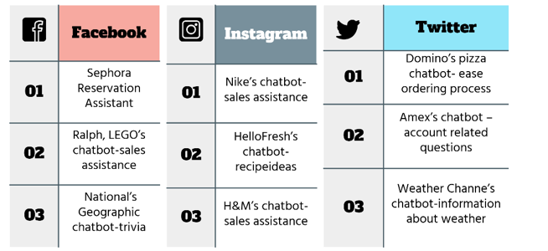
Chatbots on social media

Slide 8

Are we influenced to buy certain products?

Slide 9
Influencer marketing
Mega-Influencers:
Micro-Influencers:
03
01
>1 million followers
>10.000
<100.000
followers
Macro-Influencers
04
Nano-Influencers
02
>100.000
<1 million
followers
<10.000
followers

Slide 10
Virtual influencers
A
Digital creation
B
Controlled entities
C
Consistency

Slide 11
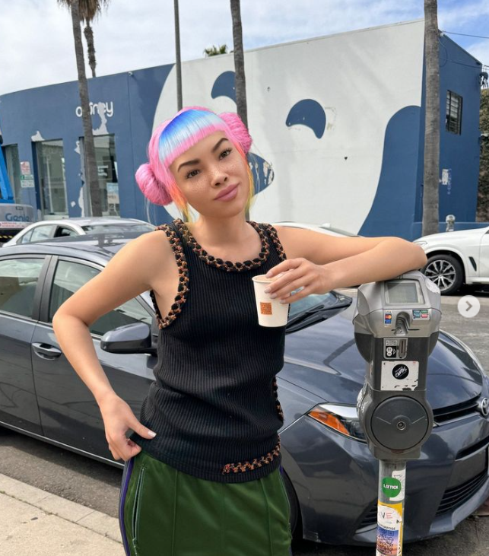
Meet Miquela de Sousa
Mega-Influencer
Earning
03
01
2.6 million followers
2020: £6550 for each sponsored post
Singer
04
Collaborations
02
>80,000 streams
per day on Spotify
major brands like Calvin Klein and Prada

Slide 12
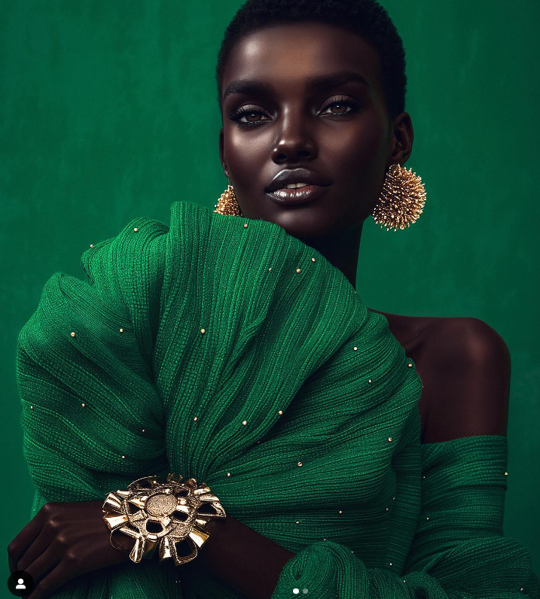
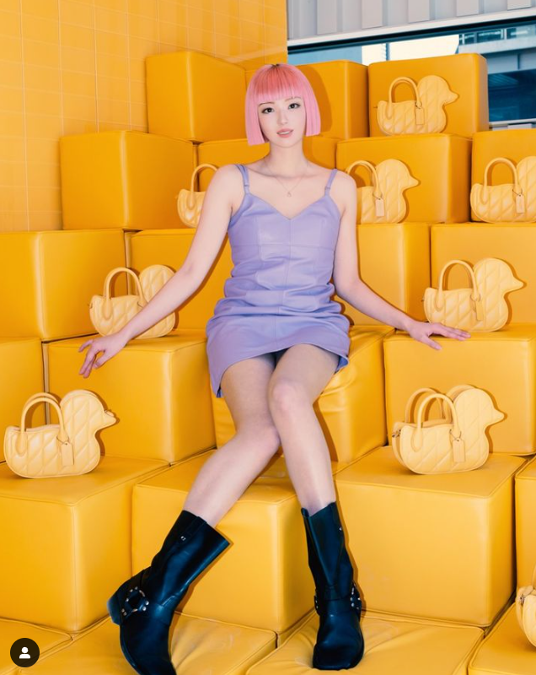
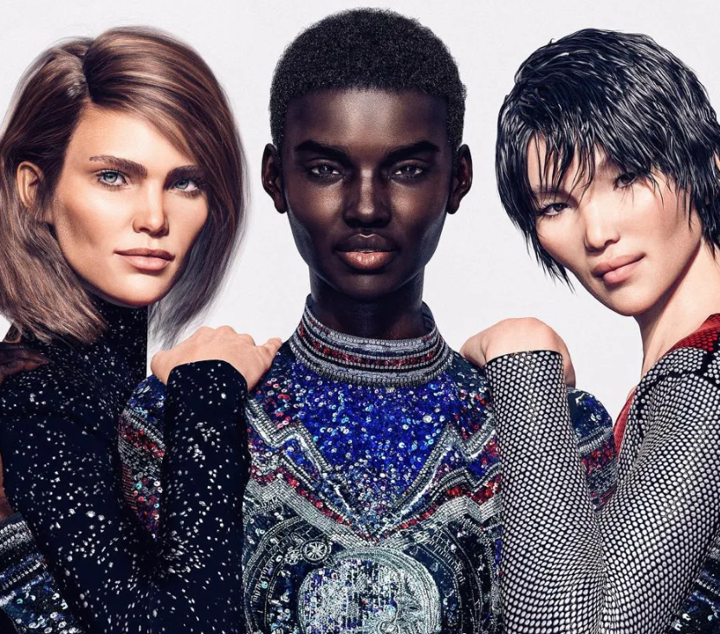
Similar examples
Shudu Gram
Imma
Digital Supermodels- Balmain

Slide 13
Experiment: Can I also be an influencer?
1
3
?
2
4
Used ChatGPT to create a script and a prompt
Add the script
Used an AI tool to create a character based on images with me
Animate the character with the prompt
The result?

Slide 14
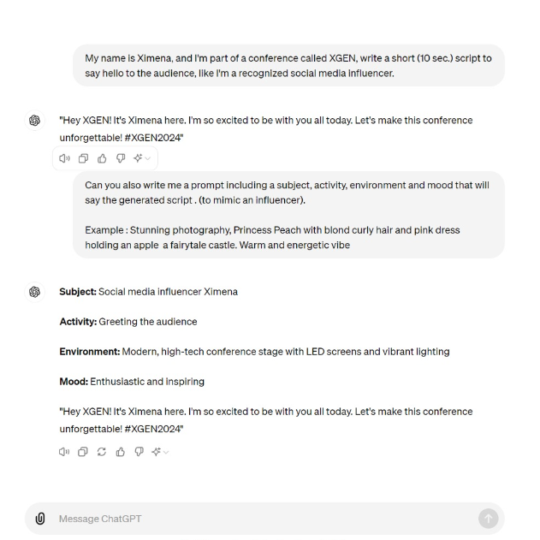
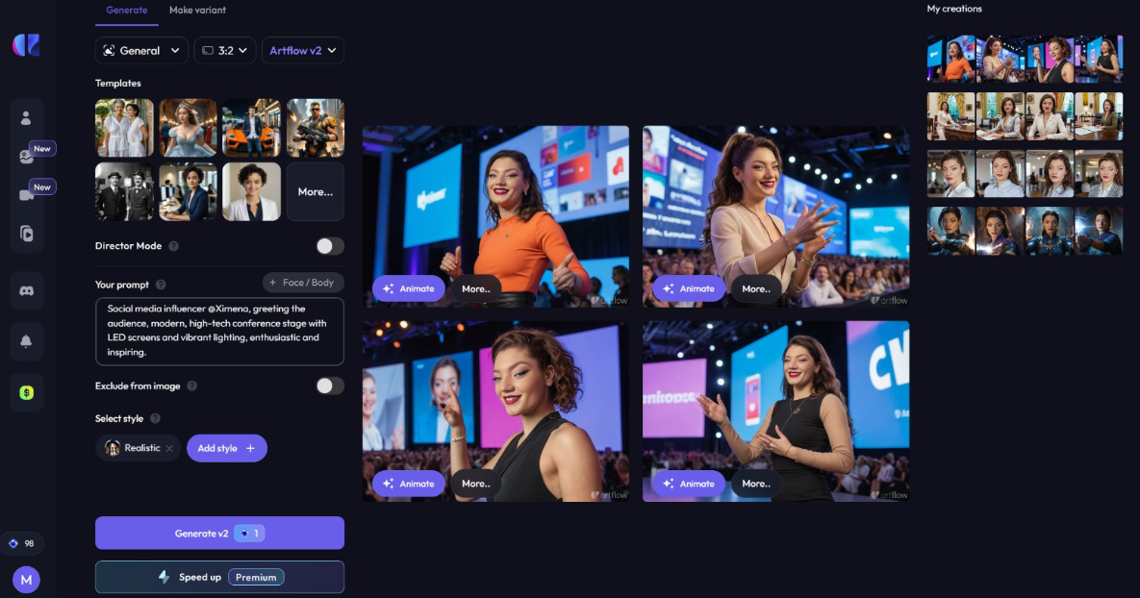
?
Experiment: Can I also be an influencer
2
4
1

Slide 15
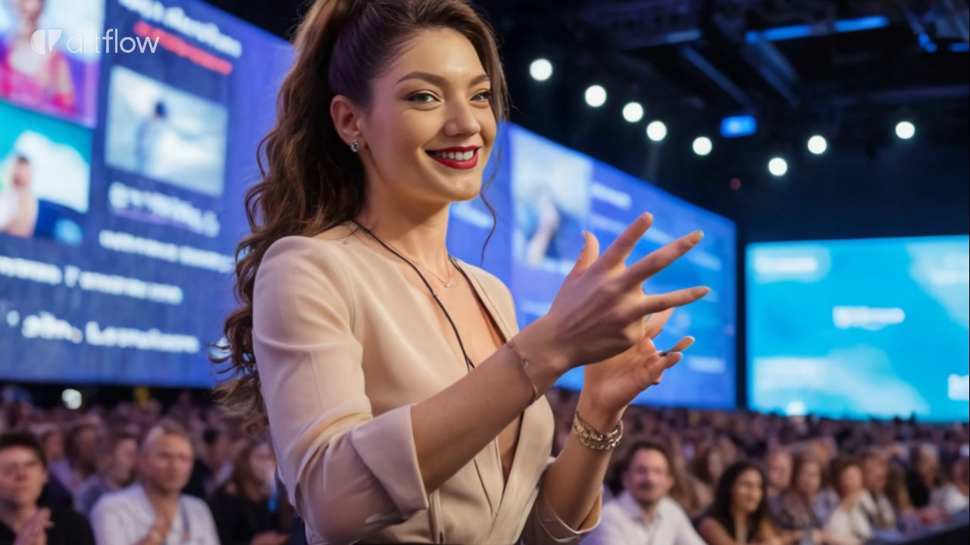
Result

Slide 16
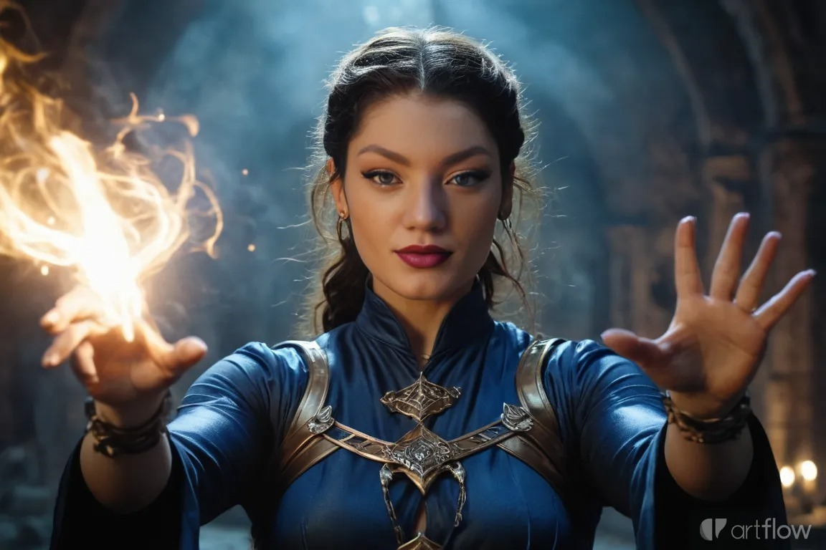
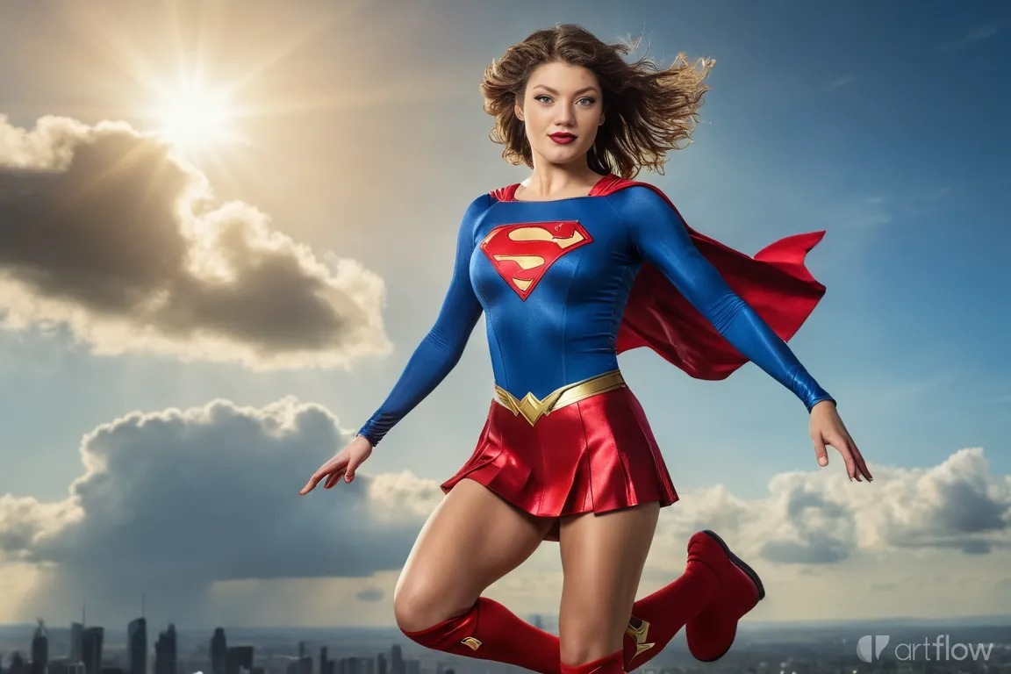
Not only can I be an influencer, but I can also be a superhero

Slide 17
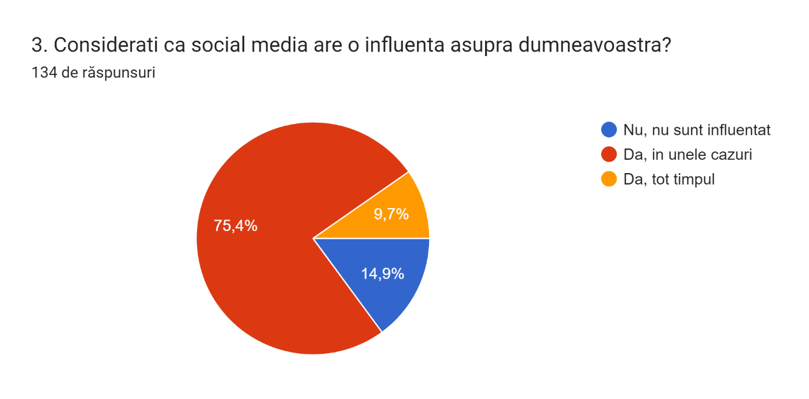
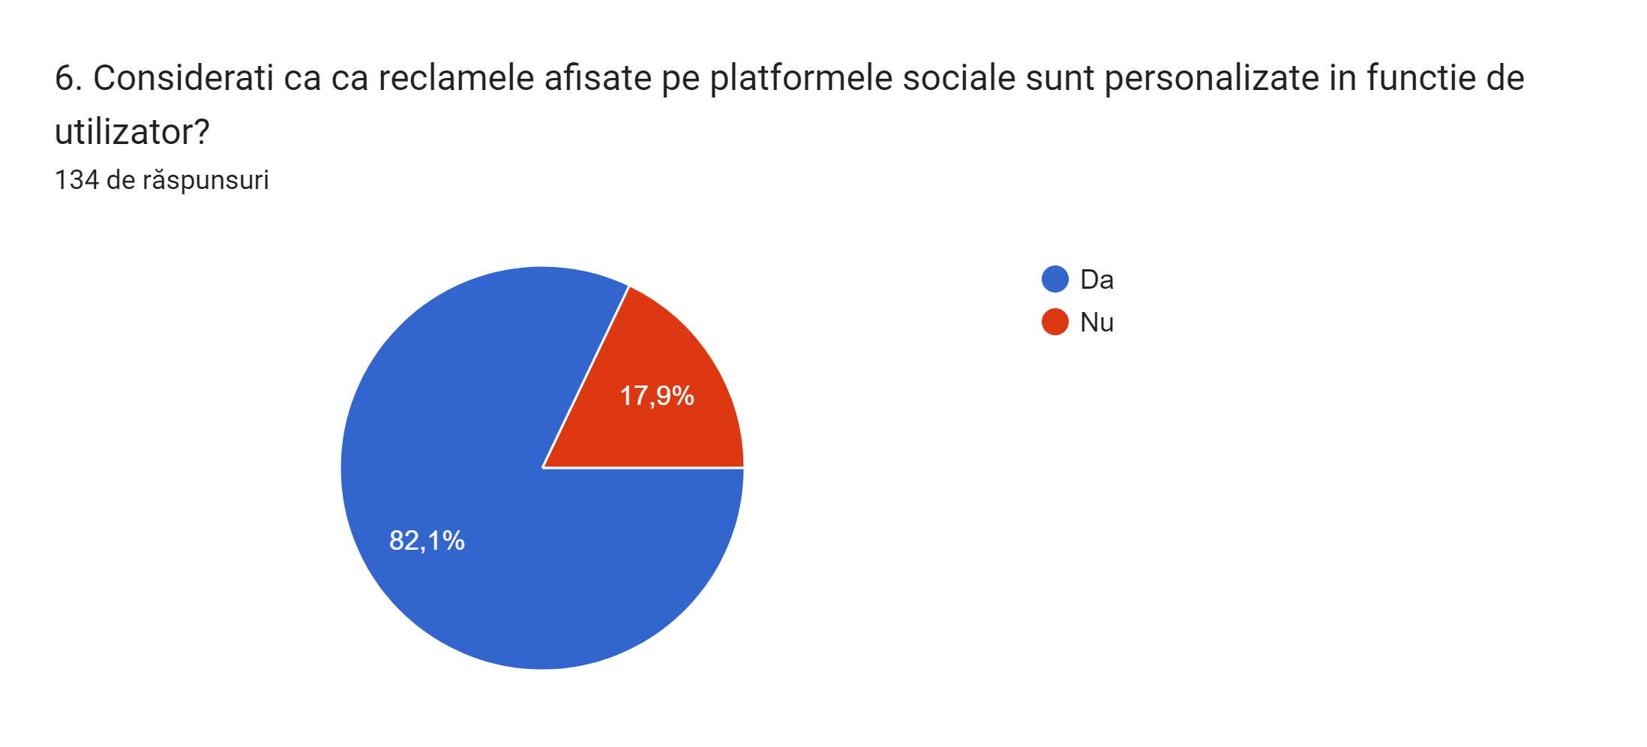
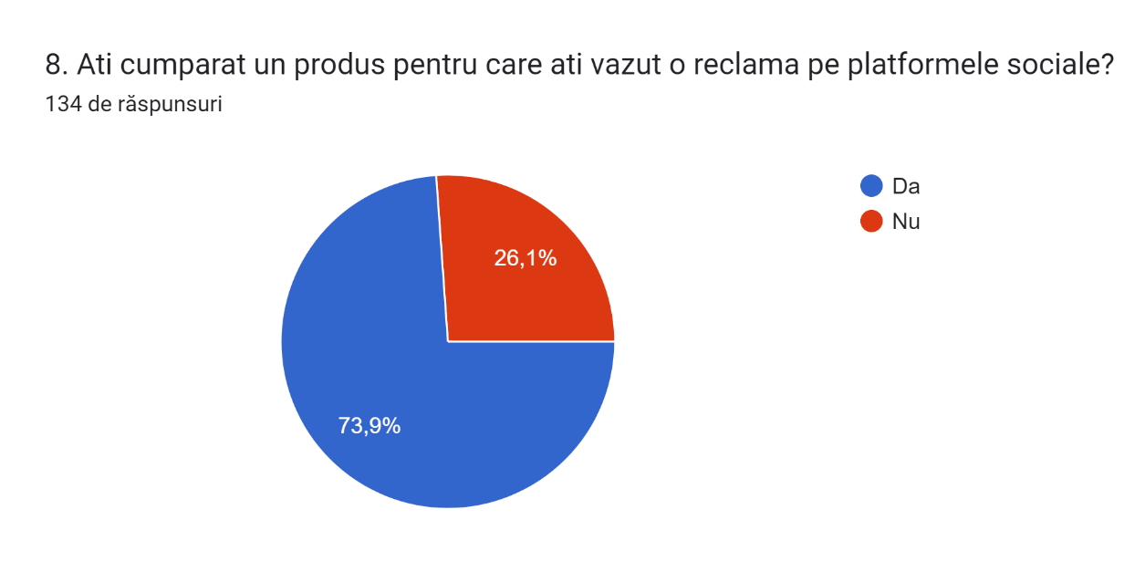
Questionnaire results

Slide 18
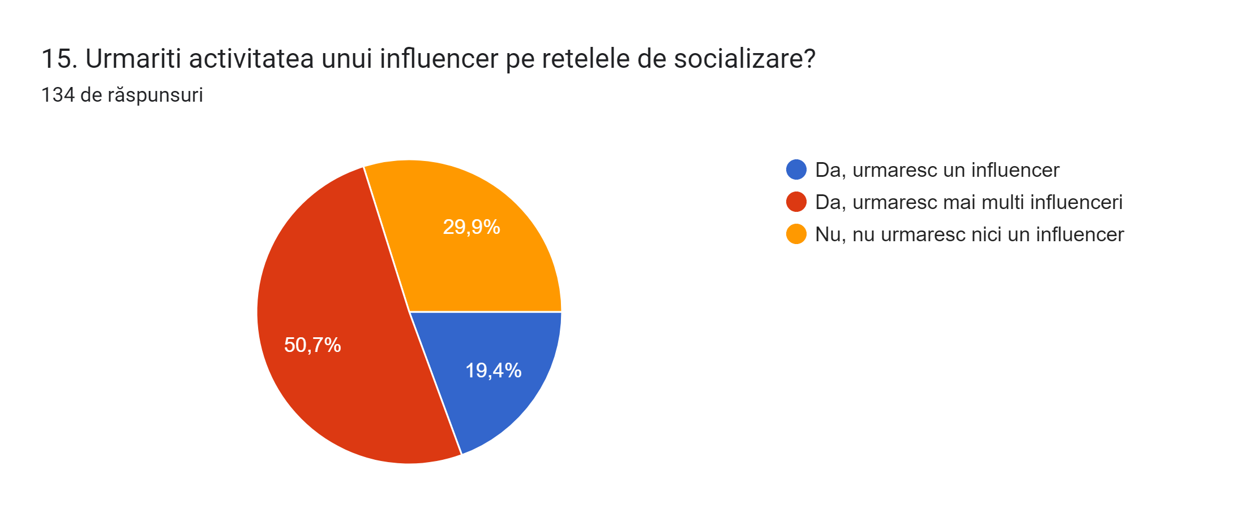
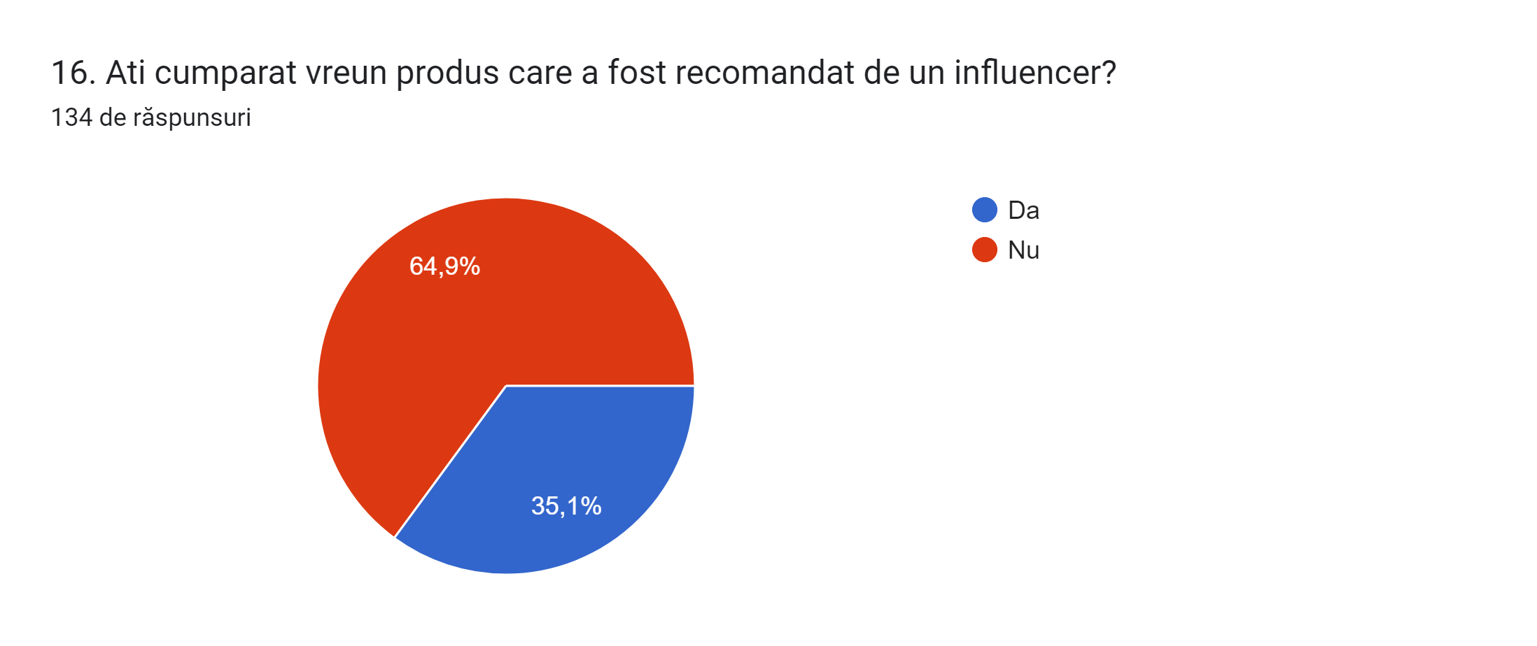
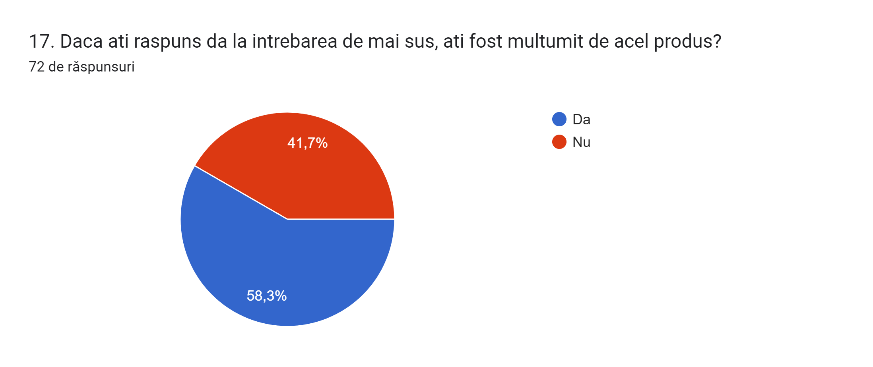
Questionnaire results

Slide 19
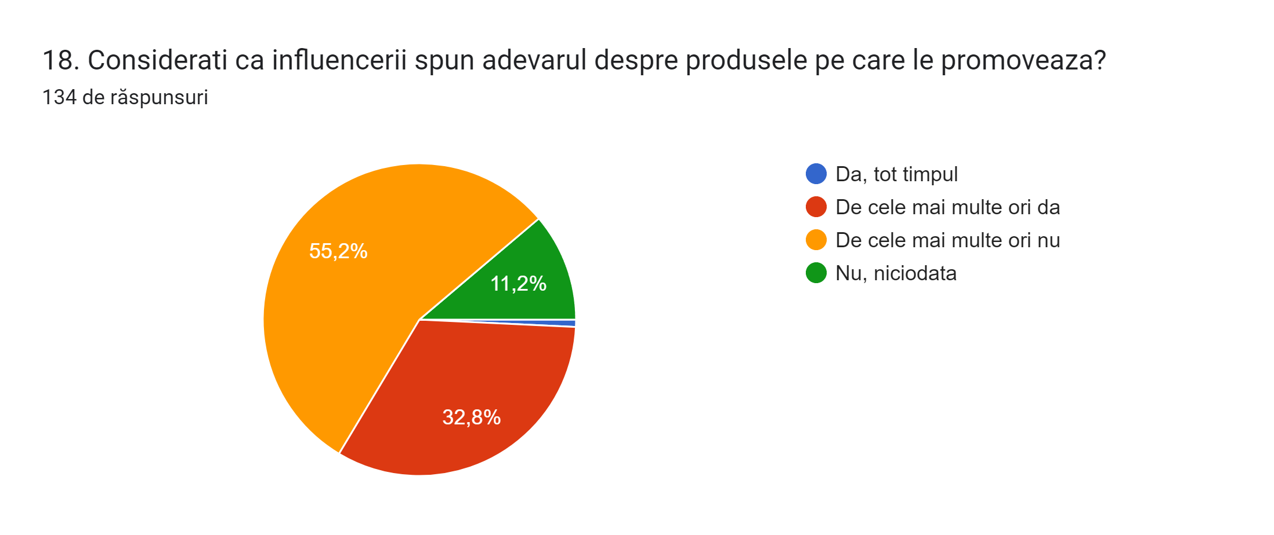
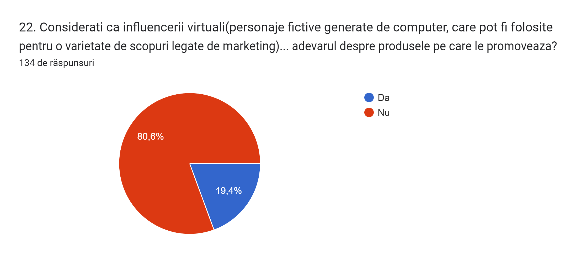
Questionnaire results

Slide 20
Ethical considerations
01
02
03
04
05
Privacy issues
Deception
Manipulation
Discrimination
Responsibility

Slide 21
Conclusions

Slide 22
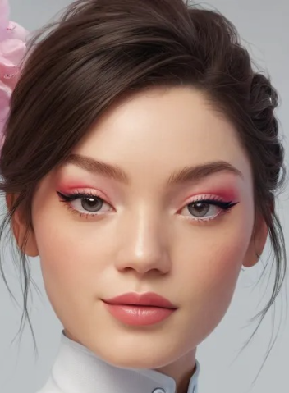
Q &A
Thank you for your attention!

