Slide 1
The Changing Nature of Money
Author/s: Sever Andrei, Bedea & Emil Lucian, Crișan
Affiliation: Universitatea Babeș-Bolyai of Cluj-Napoca
Notes:
Hello and welccome, thank you for having me today and I am glad to begin presenting what me, Sever Bedea, and Doctor Crișan have managed to create together. The short study into The Changing Nature of Money -> Slide

Slide 2
Contents
Introduction
Description of the phenomenon
Factors affecting the changing nature of money
Opportunities associated with the phenomenon
Effects on Management & Conclusions
Notes:
This paper consists of the following topics of interest that I shall be showcasing today The description of the phenomenon, the factors affecting the changing nature of money, the opportunities associated with the phenomenon and the Effects on Management as well as conclusions, feel free to raise your hand for any questions you might have during the presentation, I shall be glad to answer them. So, let us begin with, a short introduction into the subject at hand -> Slide

Slide 3
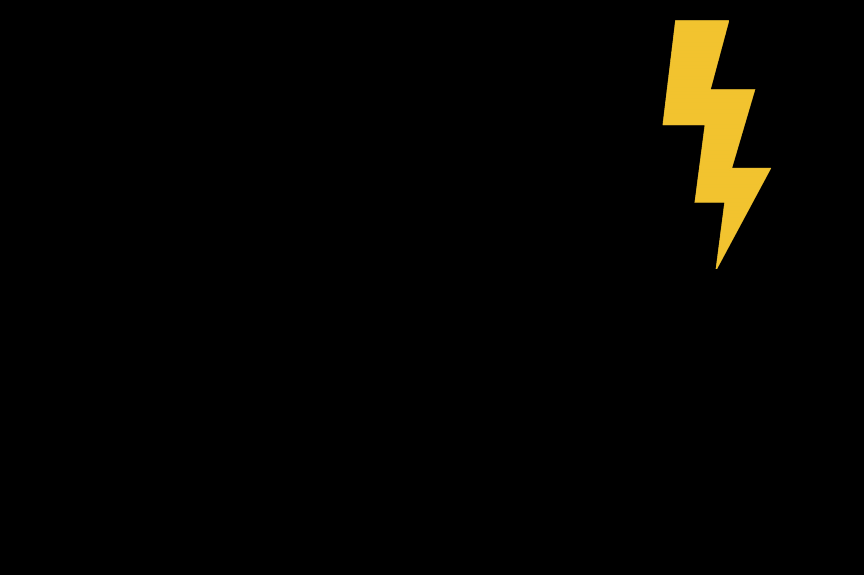




Introduction
Value
Value
Notes:
Many of you are probably acquainted with the money and what it is used for, some prefer using cash other credit cards and so on but few of us delve any deeper into the subject and investigate it’s overlooked aspects and nature. As such, the purpose of this paper is to put on display the journey that the concept of money and our understanding of it took throughout history and how we might potentially benefit in the end from truly understanding it. This has been achieved through an examination of the available resources, compiling their general knowledge and presenting the key aspects under a concise and productive manner. So I invite you to relearn the concept of money, and in order to do this we must first forget of what we call money and rebuild our perspective of it, I invite you to take a moment and simply forget …. Ok now the first step of the way is to think of money as simply a token, a representation of assigned value. -> Slide

Slide 4
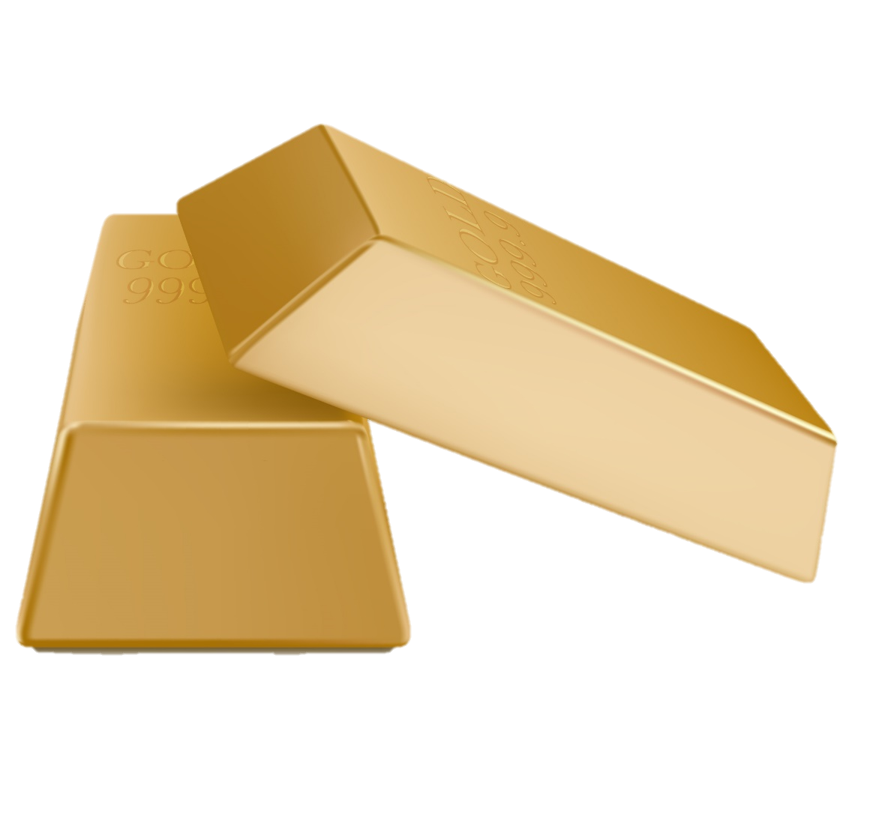
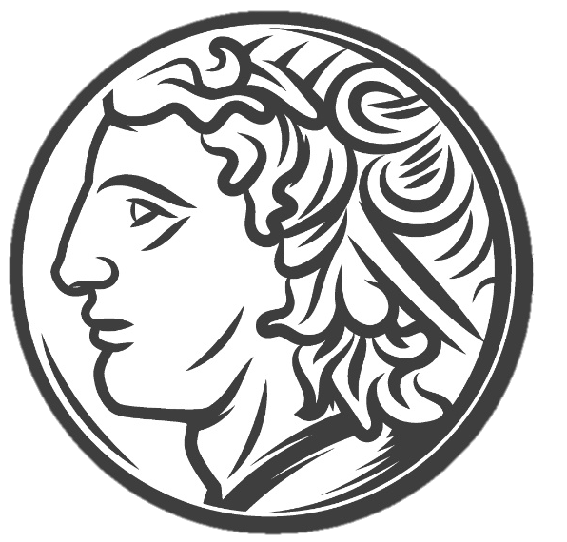

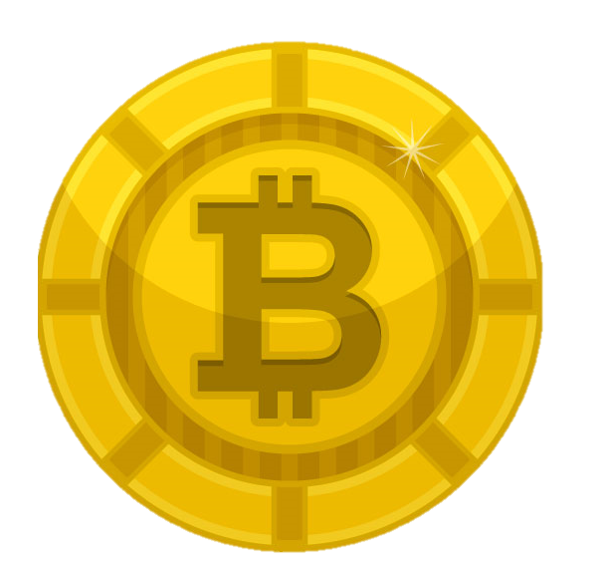
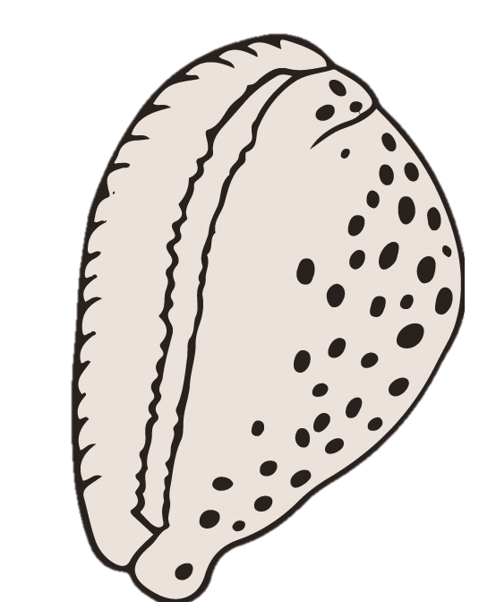
Description of the phenomenon
Cowrie Shell
Manufactured metals
Standardization
FIAT
Crypto
TIME
13.000 B.C
Today
Notes:
Now with this very basic and open ended understanding let us journey a bit through time and see the concept of money evolve before our eyes. First, humanity adopted as one of its first mediums of exchange, tokens, money, the humble cowrie shell around the 13th century B.C. Before we may assume people mostly used a rudimentary barter and favor system between individuals. So one might wonder, why the change, well the cowrie shell presented some interesting characteristics as in people thought they were quite beautiful and wanted them, it also helped that you couldn’t really counterfeit them you had to extract them from beaches so there weren’t many to go around, and when one had many, they were rather small and portable, up to a certain extent. So they were in limited supply and accepted by a majority as a display of value and portable, remember those characteristics as we may believe that other civilizations from around the globe might have started using other raw goods and biological materials but soon something better was discovered, manufacturing metals. Which proved a whole lot more durable than cowrie shells and humanity went trough different metals until mainly settled on gold as a staple of commerce due to its ability to withstand exposure but it was in such a short supply less durable and more abundant metals were often used but always exchangeable creating a hierarchy of value within the periodic table, the more durable and scarce the more valuable a metal became which means that the value in metals is divisible, fact exploited within entities such as the Roman empire which standardized metals and created coins from those metals which they were able to alter and devalue. After the standardization of coins, together with the appearance of banks, came a new improvement, a representation of gold in the form of the promissory note which links paper to “money” but soon enough the more portable paper note became accepted as “money” itself the link slowly loosing strength until in the 20th century it was broken completely, creating FIAT money. This lead to a financial revolution which opened money to be used as a tool of creating more money and wealth being shackled by nothing more than the good word of the government.
But the future brings change, with advancement in computing and cryptographic technology a new form of money that promises to be everything money should be is emerging and seeking validation, crypto currencies -> Slide

Slide 5
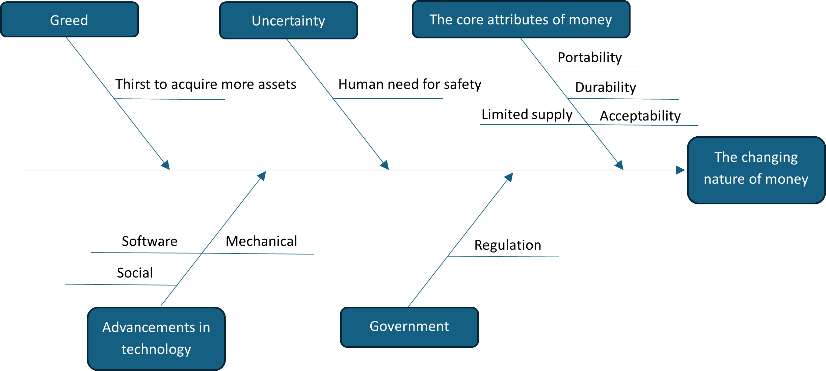
Factors affecting the changing nature of money
Notes:
I have previously mentioned key characteristics of certain forms of money, I would like to summarize them further by using a Fishbone or Ishikawa diagram in order to understand what role they play together with other factors in shaping the nature of money. The core aspects of money or its characteristics. It is probably one of the most important factors which all the other one’s tie to, hence the reasoning behind depicting it closest to the phenomenon. Money has to be durable enough to use over many transactions, portable in order to be effectively transitioned, in limited supply in order to assign value to it and most importantly it has to be accepted as a valid representation of value. Those characteristics drive the change itself, whenever a society values one characteristic above another we observe a change, an evolution of money. The most recent example, again, is crypto currency. We observe that people wish for security and anonymity, for stability and a coin that is not prone to rampant inflation and one that cannot be controlled, and thus from those needs, and using the most modern technology, came the wish to replicate gold but advance it within the new digital age, and money changed yet again. Along those attributes I have inserted a couple of other forces that have been observed to drive the changing nature of money, that being Greed which is the thirst to acquire more assets, uncertainty which is the human need for safety, the government which drives regulation and policy within a society and finally the advancements in technology mechanical and software, which allow us to create better money and also social which allows us to accept certain forms of money, and I hold this in high regard amongst the other because the idea that our society has advanced far enough into the future so that we now accept bank account balances as a form of wealth instead of barrels of wheat seed is amazing and I hardly doubt that a medieval peasant would accept the FIAT system without harsh coercion. -> Slide

Slide 6
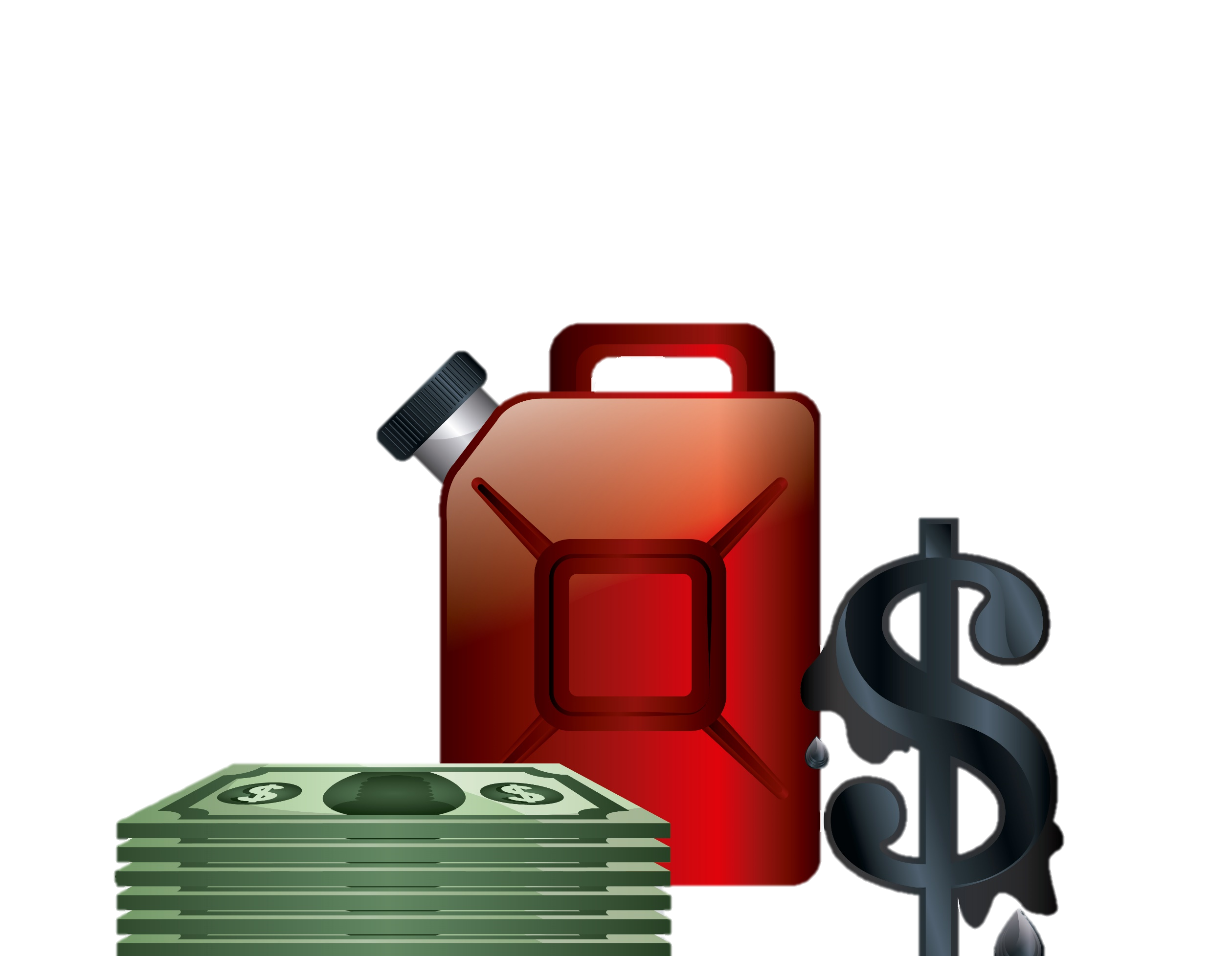



Opportunities associated with the phenomenon
Currency manipulation
Alternative investments
Early adopters
Quantum ComputinG
Notes:
Now that we have covered and described the main characteristics of money and have a better understanding of it, it remains to research what the current and future state of it allows in terms of opportunities and threats. At the very top of the food chain, so to speak, we have nation states and government which have been affected in interesting ways by the changing nature of money, often the power exerted by one state over others includes disseminating the said country’s currency as a form of reserve assets for the rest, in our age the might of the United States economy has created the US “petro-dollar”, the world’s reserve currency which means that there is an almost endless request for dollars which strengthens not only currency itself but also the issuing power. Secondly local communities have been affected by FIAT and the continuous inflation cycles so much that opportunities for wealth retention have to be created. Such opportunities are most abundant at the individual level as the emerging crypto currencies offer a solution for securing one’s wealth and being an early adopter of such coinage may prove beneficial for the individual as on top of the wealth protections offered, the individual stands to gain in the form of asset valuations as a reward for his interests and ambition in paving the way for money to evolve. As a last statement on this particular topic, and a main threat to the new technology is brought by the field of quantum computing which in the last couple of years has made headwinds. If this field advances far enough it would render the current encryption of crypto currencies useless unless, and here is where the opportunity comes in, entrepreneurial spirits engage in the realm of quantum computing in order to create better cyphers and protections for cyber wallets -> Slide

Slide 7

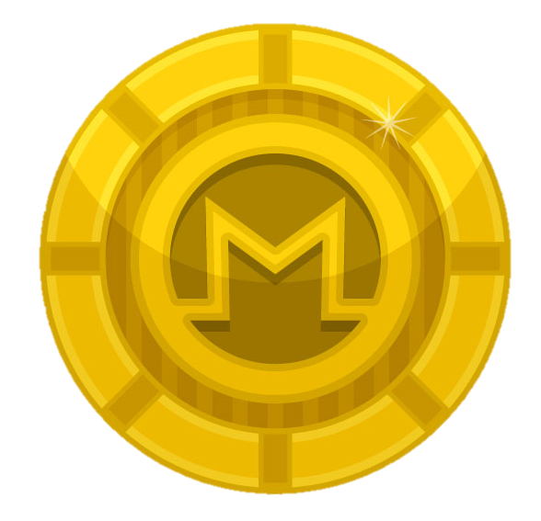
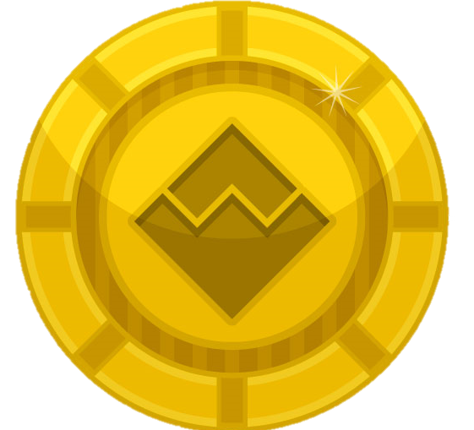
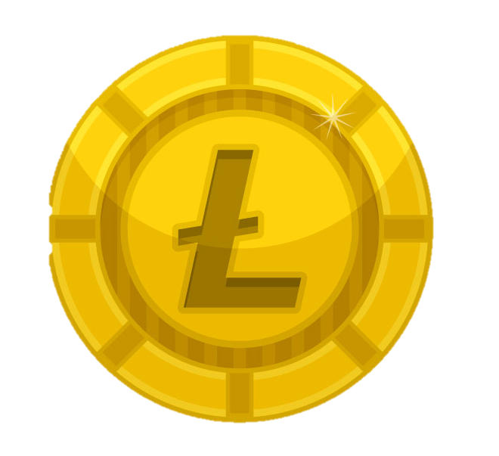
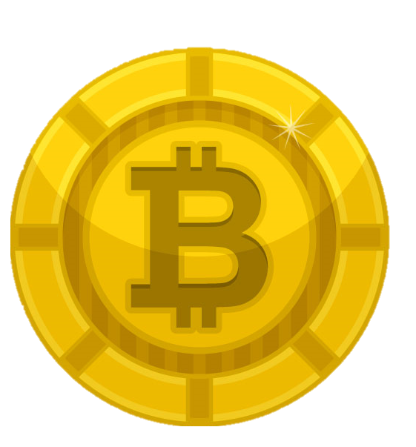
Effects on Management & Conclusions
Notes:
First of all it has been made clear that the changing nature impacts everything and everyone within society, so as far as this general statement is concerned, it would be safe to assume that managers and management, being part of the society at large are also affected. The most interesting way that this may be observed is by observing that now managers are having to take into account this change, this transition from physical to digital. After the new MiCA regulation came into effect in 2023, Mutual Fund managers have to account for cryptocurrencies and other forms of digital assets in order to run a successfully diversified portfolio and on top of this, transactions being allowed in digital denominations have had a large impact . Managers have to account for payments being made whilst managing assets and completing accounting tasks. And if it has affected managers themselves, it is safe to assume that management, as a field of study, has to be affected as well and the curriculum adjusted in order to resemble the changing in market tendencies, and there exist example of this change within universities. Within the Romanian “Babeș-Bolyai” University curriculums have started to be altered in order to accommodate for this changing nature of money -> Slide

Slide 8

Thank you for your attention!
Notes:
We have reached the end of our presentation, I thank you for your patience and attention and await any lingering questions you might have regarding what was presented. -> Slide

