Slide 1

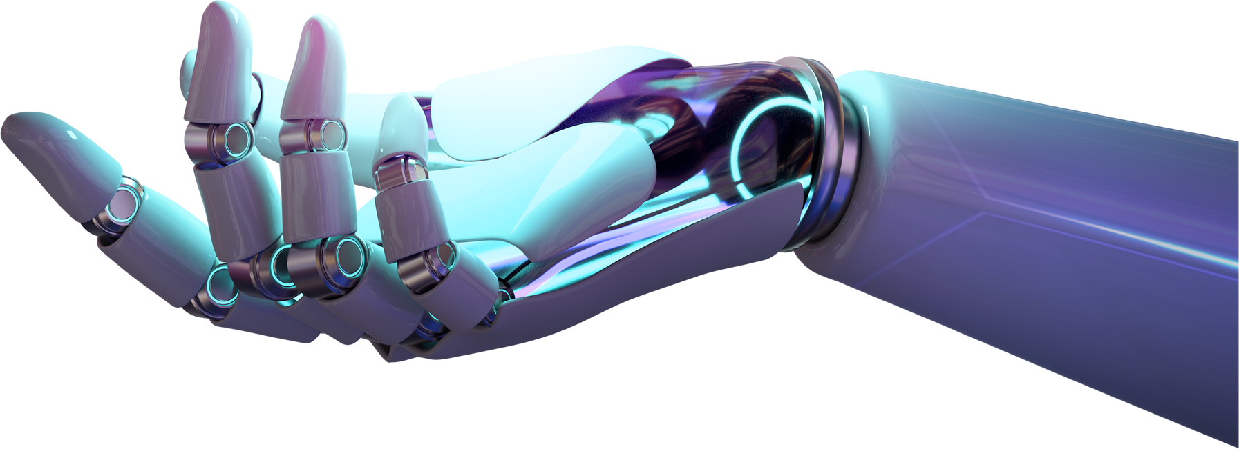
An Overview of AI-driven Recommendation Systems: Enhancing Personalization & User Experience (Qualitative Study)
AUTHORS: EMMA ENACHE & DRAGOS PAHONTU
COORDINATOR: PROF. UNIV. DR. DANIELA SERBAN

Slide 2



DEAR USER,
WELCOME TO THIS DIGITAL EXPERIENCE!

Slide 3

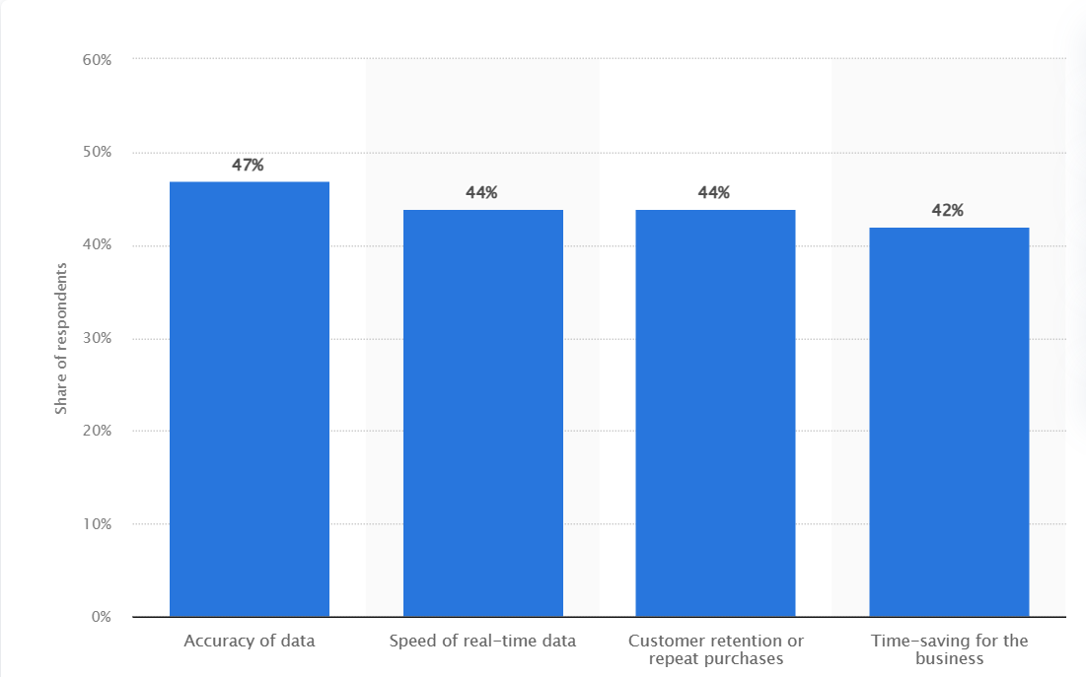

An analysis of the worldwide success of using AI driven personalization systems

Slide 4



Case studies: Netflix & Amazon

Slide 5





Facebook Beacon Case
PUBLIC AWARENESS
DIGITAL PRIVACY
PRIVACY ETHICS

Slide 6
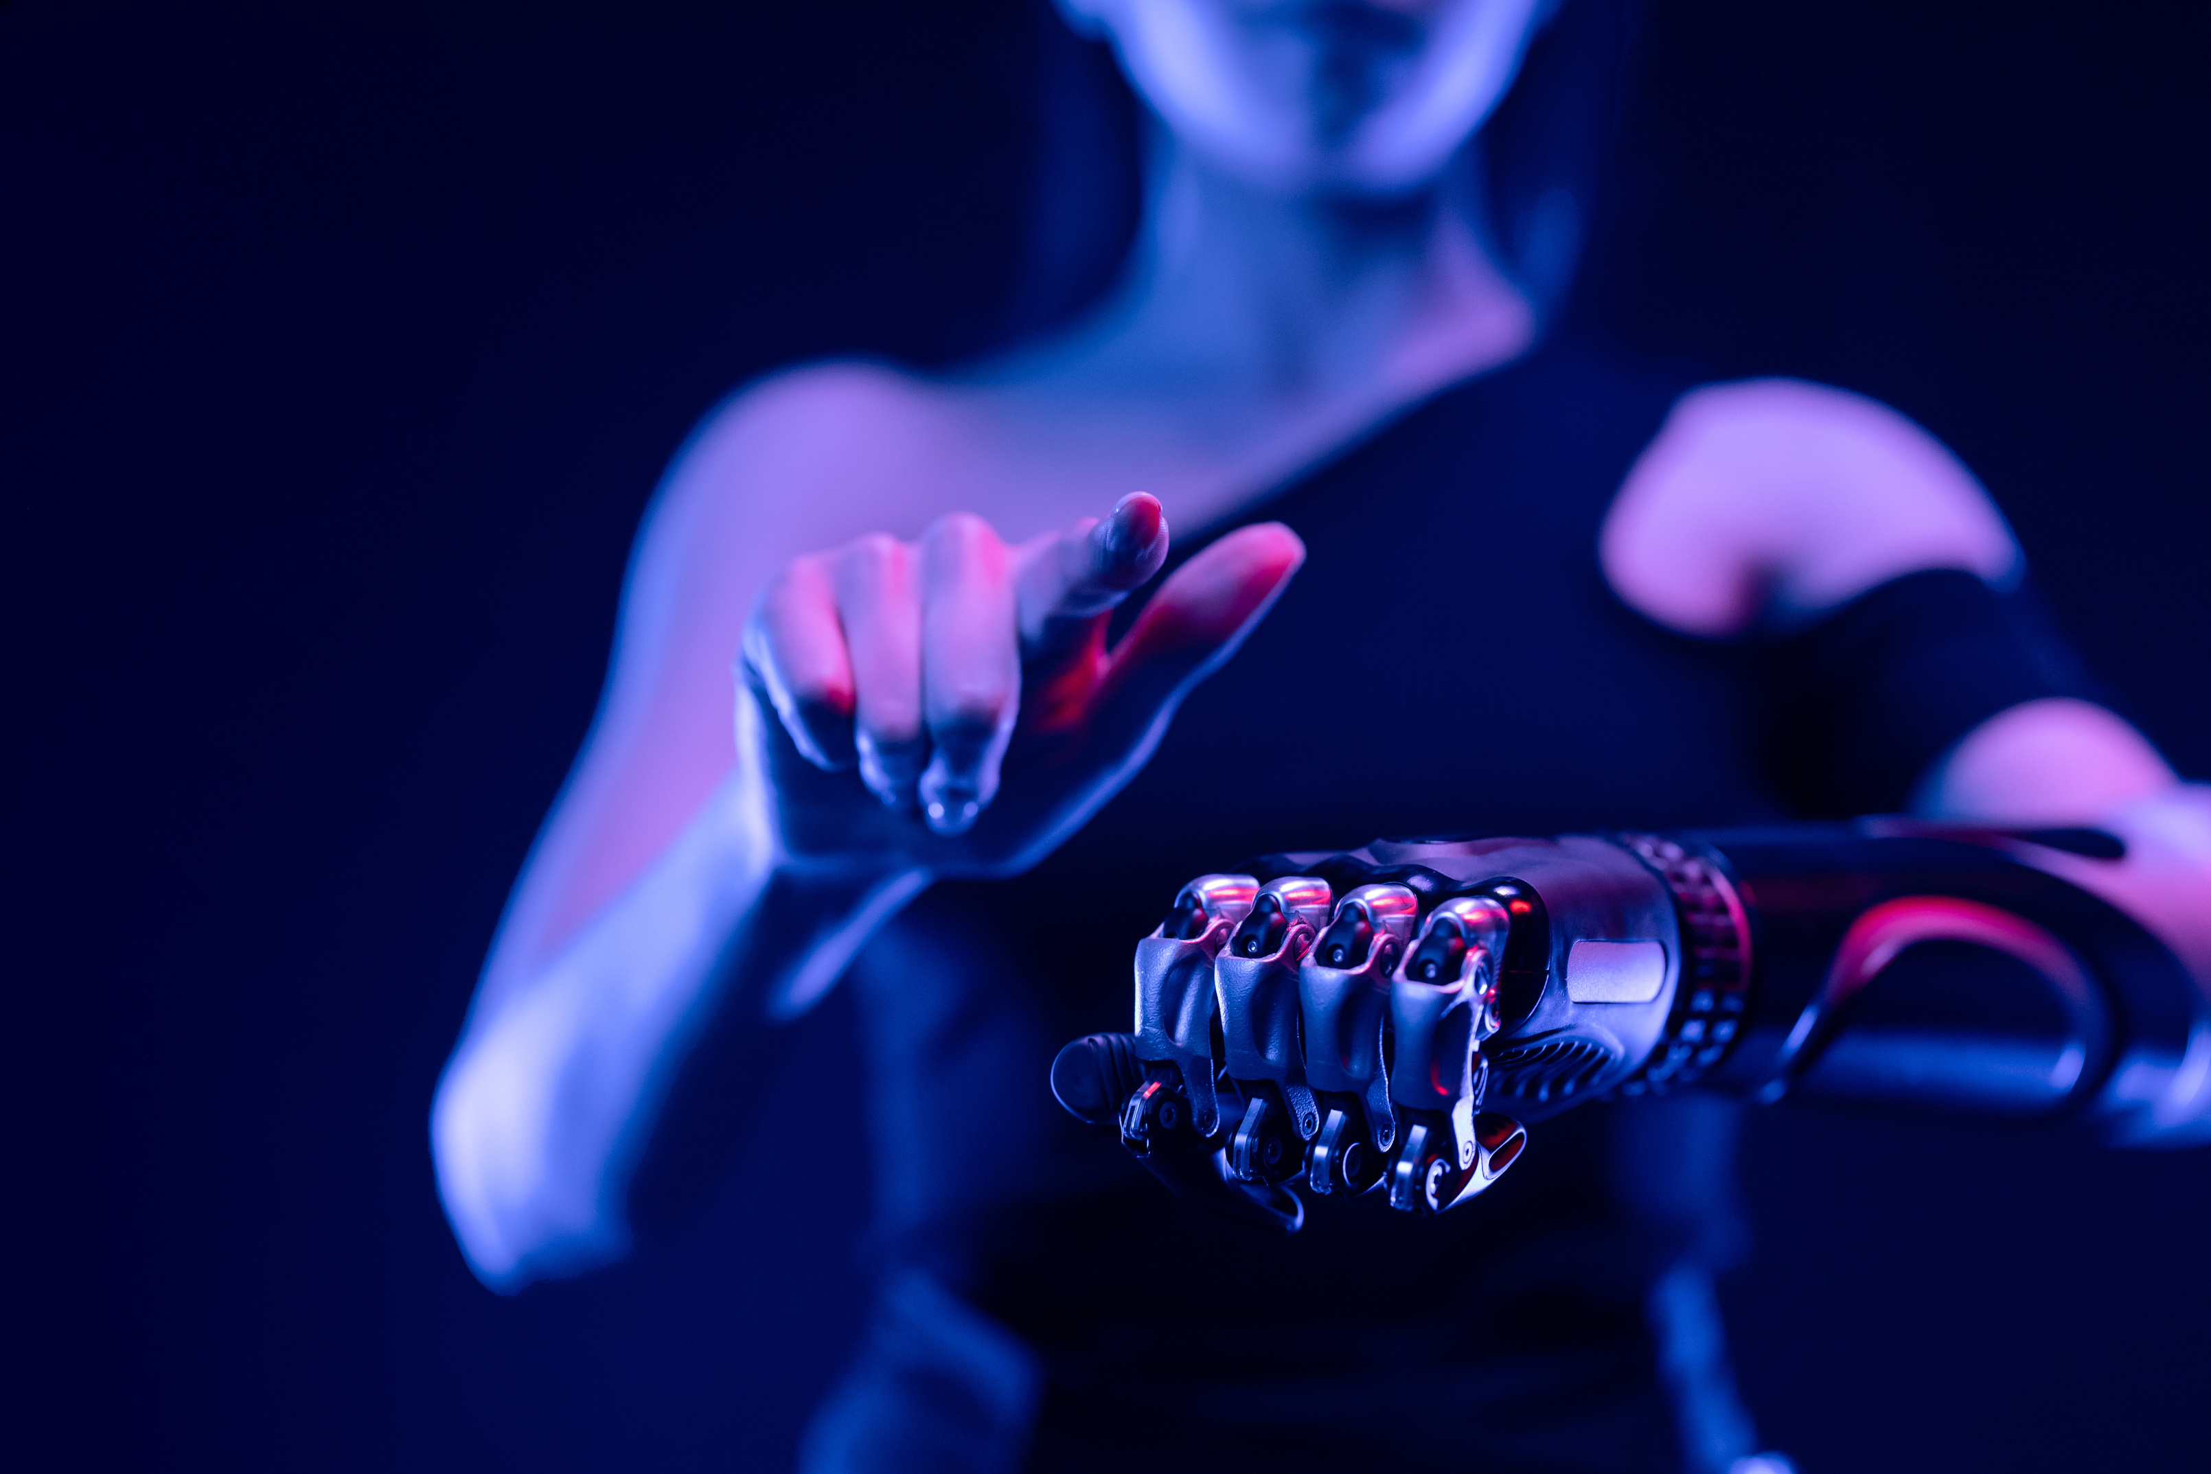
Conclusion
'Even a cat has things it can do that AI cannot’ - Fei-Fei Li

Slide 7
Thank you
Q & A

Slide 8
References
  Alimamy, S., & Gnoth, J. (2022, March 1). I want it my way! The effect of perceptions of personalization through augmented reality and online shopping on customer intentions to co-create value. , 128, 107105-107105. https://www.sciencedirect.com/science/article/pii/S0747563221004283
  Batchelor, N., Houston, D., Larson, S., Nanjundaram, S., & Vota, W. (2014, May 19). Facebook Case Study. https://www.scribd.com/document/225029977/Facebook-Beacon-Case-Study
  Chevalier, S. (2023, September 28). Ways in which companies measure the success of using artificial intelligence (AI)-driven personalization worldwide 2023. Retrieved March 23, 2024 from https://www.statista.com/statistics/1415821/success-measurement-in-using-ai-driven-personalization-worldwide-2023/#statisticContainer
  Gomez-Uribe, C A., & Hunt, N T. (2015, December 28). The Netflix Recommender System. https://doi.org/10.1145/2843948
  MacKenzie, I., Meyer, C., & Noble, S. (2013, October 1). How Retailers can Keep up With Consumers Retrieved March 9, 2024 from https://www.mckinsey.com/industries/retail/our-insights/how-retailers-can-keep-up-with-consumers#/

